Slide 1
Story Writing @ OLG Digital
A comprehensive guide

Slide 2
Course Overview
Agenda
Introduction to User Stories
Story Flow For Delivery Teams
Idea Shaping
Idea Shaping in a Nutshell
Introduction To Story Mapping
Identifying Marketable Increments Of Value
Discovery Your Next Market Increment
Discovery in a Nutshell
Refining Marketable Increments of Value on Your Story Map
Story Mapping Practices to Encourage & Avoid
Planning, Scheduling, & Forecasting
Story Exploration
Story Exploration in a Nutshell
Writing Story Acceptance Criteria
Refining Your Story Map During Story Exploration
Defining System Level Stories
Story Specification
Story Testing
Outcomes
This course is intended to prepare you to develop software effectively in conjunction with your digital engineering lab-mates
We will be covering all aspects of how to efficiently analyze and capture new ideas, break them down into bite-sized pieces, and refine them into stories that can be consumed by your development team
Structure
Each module will consist of a lecture component, followed by a homework assignment
Lean on the coach assigned to your lab if you need help with completing the homework

Slide 3
Introduction to User Stories
What Are Stories and Why Do We Use Them?

Slide 4
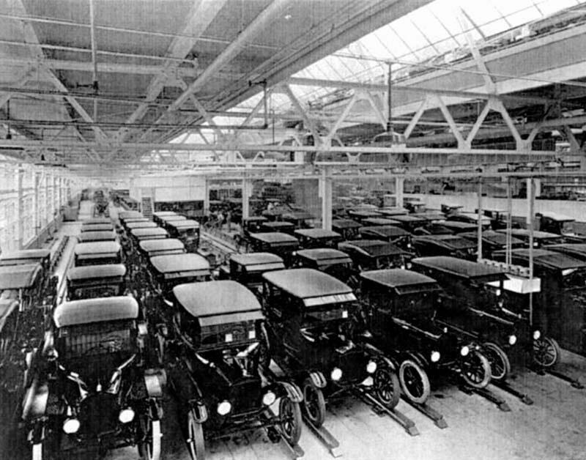

At the turn of the last century, organizations were designed to get as many of the same type of goods to as much of the population as possible for the lowest possible cost.
Any customer can have a car painted any color that he wants, so long as it is black.
As a result, industrial era organizations were built around the concepts of standardization, division, and control.
The results were the creation of wealth and employment at a hitherto unprecedented scale
Notes:
Question > can anyone tell us what the market conditions were like in the early 1900s?
Fast-growing, spacious markets
Relatively little competition
Sluggish markets
A largely Uneducated Workforce with an Educated Management
Question > can anyone tell us what the market conditions were like in the early 1900s?
Fast-growing, spacious markets
Relatively little competition
Sluggish markets
A largely Uneducated Workforce with an Educated Management
Question > What was the challenge of the Industrial Revolution?
To get as many of the same type of goods to as much of the population as we can for the lowest possible cost
To Employ the population so they could afford to buy all of these items
And by these measures the industrial era was a success
Question: What Can you tell me about the nature of the work ?
Repetitive
Specialized
Following exact Instructions
Attributes of an industrial era organization
Deep hierarchies
Division of labour
Thinkers vs doers
Plans, designs, instructions -> detailed and precise
Focus on cost, efficiency, standardization
This was all fit for purpose for that era

Slide 5


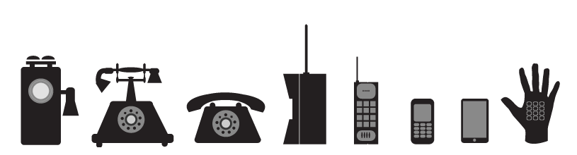
Markets are both more crowded and move faster than ever before
Notes:
Question: How the market today different than the industrial age?
Global and highly competitive markets
Platform business (eg AirBnb)
Technology Innovation -> Digital, cloud, social-media, mobile, machine learning, we are always connected
Work-force is, for the most part highly educated
What are the results
Highly segmented user base, differentiated experiences (mass customization)
Product Life Cycles are exponentially shorter and continuing to shrink (PC > mobile > social media)
Question: What Is The Challenge of Today’s Era?
- To provide differentiated solutions that create customer delight and loyalty to an exact and exacting audience
- To deliver value in a way that is sustainable, and betters the lives of all an organizations stake-holders (employees, customers, shareholders, community, suppliers)

Slide 6




Today’s markets require a different approach to introducing products to our users
The focus of the last century was centralized planning driving down cost, consistency and repeatability
Today focus is speed, growth, innovation, and maximizing feedback in the face of increasing uncertainty
You can have any car you want as long as it’s black!
Commodity limited product selection to an undifferentiated mass of consumers
Cost focus, the lowest price point
Stable and low rate of change, similar products have been built many times before
Long lead times are acceptable
Success requires a First Mover or even True Innovator mindset
Order of Magnitude increase in change of products, plans, solutions etc.
Customer Learning is key
Focus is on Speed and Learning, cost is a secondary consideration

Slide 7





We need create value by working in smaller increments of scope that can be continuously delivered and validated
Big projects and big releases are hard!
Lots of variability and unknowns!
Lots of dependencies!
Big Project
I need Shelter!
Skyscraper 2 years
I need Shelter!
Increment 1
Increment 2
Increment 3
Increment 4
Cave – 5 Days
Tent - 2 weeks
House – 6 months
Skyscraper – 3 years
Efficiency takes a back seat to delivering smaller features to the market sooner!
Agile is all about breaking big projects into smaller units of work that can deliver business value
Notes:
Analogy where the business might ask for the a skyscraper as a business requirement – this would take 2 years to complete
We could ask questions and find out that the immediate business need is to find shelter.
We can find a cave and deliver business value right away.
After we learn from that experience, we find the next immediate need is to have a bit more space, so we spend a couple weeks building a tent
The tent allows us to get more business value without a large investment
Down the line we might learn that business requires more room e.g., for a family. So we spend 6 months and build a house.
After the house we may find out that the business no longer needs the skyscraper – either because their needs have been met by the house or business needs have changed due to market conditions
Saved work

Slide 8

Stories are a semi formal narrative structure that help us describe solution functionality as small increments Of value
Good user stories are
a unit of scope
a unit of value/ behavior
a unit of planning
a unit of testing
a unit of story telling
Stories are an artifact that are owned and worked on by the entire team
Notes:
User stories are…
a unit of scope - short, simple descriptions of a intended software systems functionality
a unit of value/ behavior – typically told from the perspective of the user interacting with system and the corresponding system behavior
a unit of planning - are deliberately sized so they can be delivered with a small and predictable amount of team effort, smaller units are easier to plan and track across our delivery life cycle.
a unit of testing – user stories are elaborate according to acceptance criteria and specification scenarios that are inherently testable in and of themselves, in an ideal world separate test cases are not necessary
a unit of story telling – at the end of the day user stories are meant to help describe how a system should function by using a semi-formal narrative structure that helps teams and have better discussions

Slide 9



Above all, Stories are action oriented, and they describe interactions between users and systems
Telling a good Story involves discussing how we want the system to behave in response to a user interaction
Manage User Accounts (User Goal)
Register New User Account ( User Activity)
Enter Contact Details (User Task)
It is hard to tell a good story by focusing on the delivery or development tasks required to build a system or on system internals
Build Registration Database
Research User Preferences
Design Contact Details Entry Form
Tip: Focus Stories on User Interactions and how the system behaves as observed by the users, document tasks and system internals using other artifacts

Slide 10
Story Flow For Delivery Teams

Slide 11






Stories are an approach that allow teams to focus on multiple levels of detail based on where they are in the discovery and delivery flow of work
Epics Business capabilities, end-to-end business processes, or end-to-end customer outcomes
Features Concrete, smallish grouping of of business value that is natural to define, develop, and test at the same time
User Stories Captures a small increment of system behavior that a user can see
Stop Here!
System Stories Captures a small increment of system behavior that crosses a system
Tasks Captures team work required to develop or test one or more stories, but
does not describe any system behavior
Tip: Avoid writing stories below sea level, i.e., a discrete user action and corresponding, observable system response

Slide 12
When using stories, we break behavior down until we get to the story level and then group them according to a set of minimal viable increments
Idea Shaping
Increment Discovery
Feature Exploration
Story Eng.
Feature Testing
Increment Testing
Epic
Epic
Market Increment
Business capabilities, end-to-end business processes
Major objectives, and/or end-to-end customer outcomes
Contains 4 – 7 Features
Eg: Purchase Lottery Ticket
Feature
Feature
Feature
Feature
Feature
Feature
An integrated unit of scope that is easy to define, develop, and test together
Can be completed by a team within 1-2 sprints
Between 4 - 7 Stories
Eg: Purchase With Existing Card
Story
Story
Story
Story
Story
Story
Story
Story
Story
Story
Story
Story
Story
Story
Story
Story
Story
Story
A granular increment of testable and product verifiable work
Completed by a couple of team members in less than a week
5 – 9 Acceptance criteria or 3 – 5 testable scenarios
Eg: Display Players Existing Cards on Web
An increment of work that is deployed to real users in production
Teams should complete within 6 – 12 weeks
Eg: Purchase Lottery Ticket via Direct Pay with an Existing Card on Web
Tip: Size an increment of value so that it contains no more than 7-9 items of the next level of detail (e.g. an Epic contains no more than 7-9 features)

Slide 13

Getting to the right level of detail can be thought of us progressively breaking up the boulders in our solution scope
We are often handed an entire problem statement, a large boulder
We then progressively break that up into Epics and Features, our individual rocks
And then further define, deliver and test individual stories, our pebbles
We then aggregate those stories back into features, and increments and test and release them in a bundle
We call this approach the scatter-aggregate pattern
You do the work required to decompose something into a collection finer grained unit
You then work on each increment until you are ready to reassemble your work

Slide 14

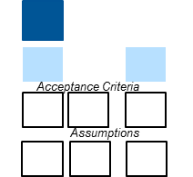
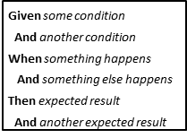
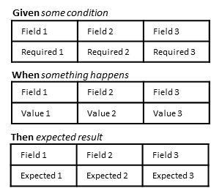
Story Flow implements the scatter – aggregate pattern using a consistent set of agile practices and artifacts
Initiative /Idea
(Minimum Viable) Increment
Feature
Story
Shaping
Discovery
Grooming
Story Specify
Story Develop
Story Test
Feature Testing
Release
Do enough Story Mapping to prioritize and size the Increments inside an Initiative
Complete the Story Map for an Increment identifying the Features and Stories
Write Acceptance Criteria for all Stories in a Feature
Incrementally analyze, build and test individual stories
Test that all stories in a feature work together in an integrated way
Test then release the next increment to production
Story Map Outline
Story Map
Write Acceptance Criteria
Story Specification Scenario
Story Specification Test case
Story Specification Test case
Tip: Design your story flow so work can move along the process in the smallest possible batches, this will increase feedback and give the team more opportunity reduce defects and introduce improvements to how they are working
Initiatives / Ideas are shaped into one or more Increments (PO/BA)
Rough order of magnitude estimate story count for each Increment by Bede Tech Team
Lead by OLG PO in close collaboration with Bede Product Manger
Approved by BY OLG PM
Story Map out a list of Features and Stories for Increment (PO/BA)
Refine stories based on technical / platform concerns (tech Team)
Schedule and prioritize Features based on team(s) estimated throughput (Tech Team + PO/BA)
Write Acceptance Criteria for all stories in a feature (BAs)
Split / group/ reorder stories in a feature as required (BAs + Tech)
Confirm ready for Dev (Tech)
Group Acceptance Criterial into Scenarios (BAs)
Refine scenario language and add backgrounds and givens
Define alternative and edge scenarios
Group Acceptance Criterial into Scenarios (BAs)
Refine scenario language and add backgrounds and givens
Define alternative and edge scenarios
Group Acceptance Criterial into Scenarios (BAs)
Refine scenario language and add backgrounds and givens
Define alternative and edge scenarios

Slide 15


Months
Story Flow can also be thought of as enabling a feedback loop at 2 different cadences
3
Grooming
Write Acceptance Criteria for all Stories in a Feature
Story Acceptance Criteria
Story Specification Scenario
Weeks
Given some condition
And another condition
When something happens
And something else happens
Then expected result
And another expected result
Story Specification
4
Incrementally analyze, build and test individual stories
Story Develop
Story Validation
5
Test that all stories in a feature work together in an integrated way
Story Specification Test case
Feature Testing
6
Test then release the next increment to production
Story Mapping
Discovery
1
Shaping
2
Complete the Story Map for an Increment identifying the Features and Stories
Increment
Test & Release
Do enough Story Mapping to prioritize and size the Increments inside an Initiative

Slide 16
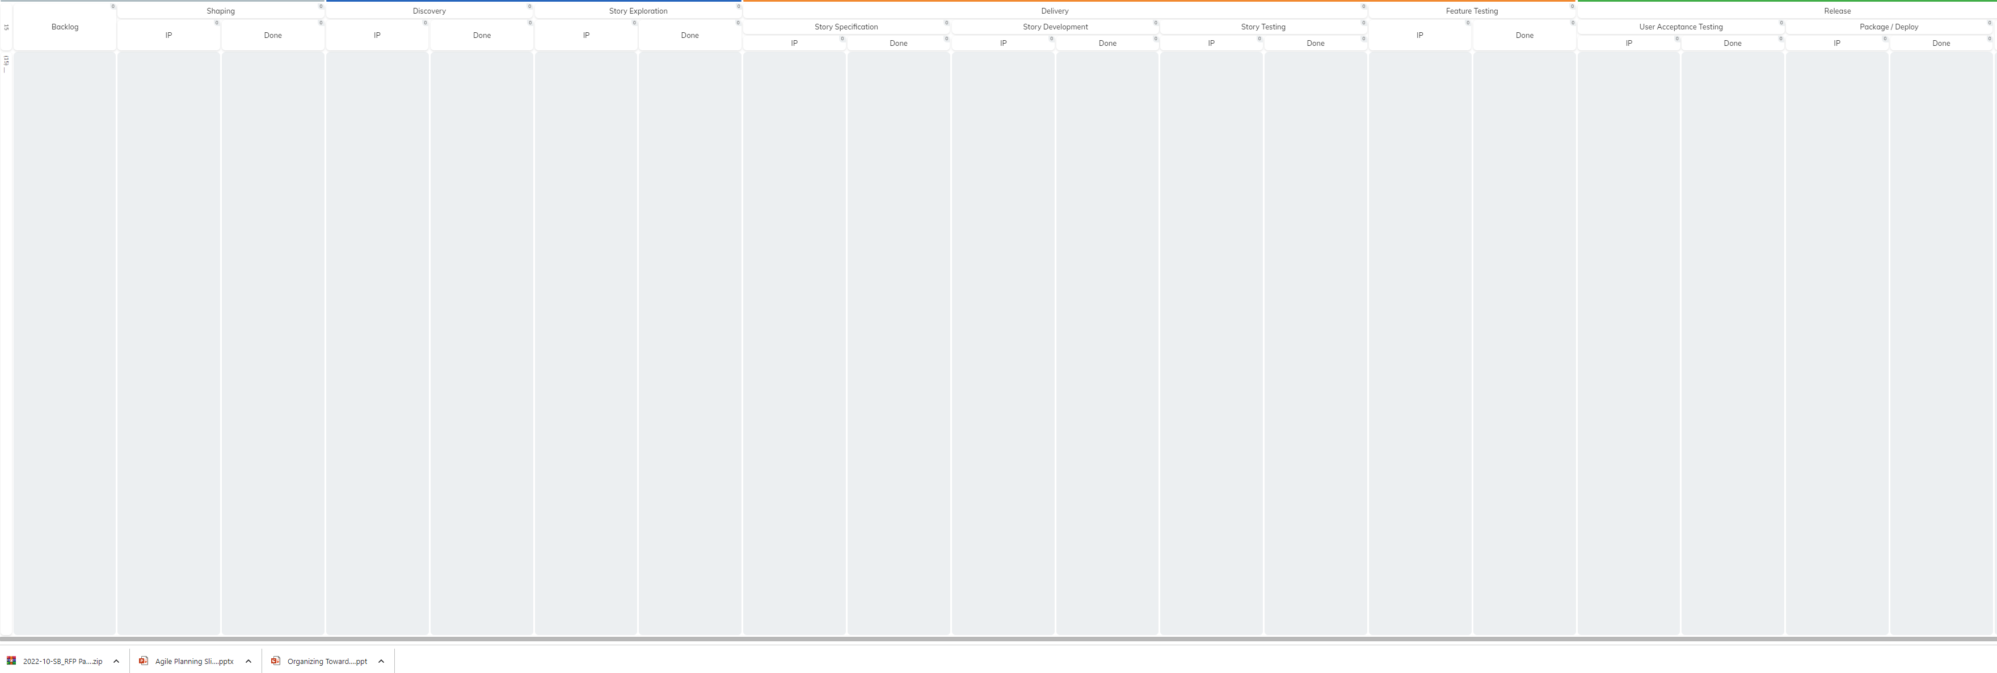
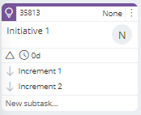
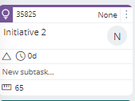
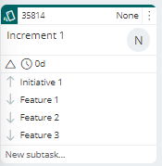
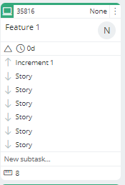
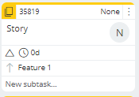
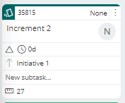
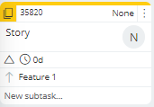
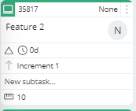
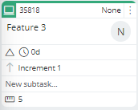
Here is what a flow of stories can look like on Kanbanize
Initiatives / Ideas are shaped into one or more Increments (PO/BA)
Rough order of magnitude estimate story count for each Increment (Dev)
Story Map out a list of Features and Stories for Increment (PO/BA)
Refine stories based on technical / platform concerns (tech Team)
Schedule and prioritize Features based on team(s) estimated throughput (Tech Team + PO/BA)
Story Map out a list of Features and Stories for Increment (PO/BA)
Refine stories based on technical / platform concerns (Dev)
Schedule and prioritize Features based on team(s) estimated throughput (Dev + PO/BA)

Slide 17
Here is what a flow of stories can look like on Kanbanize
Initiatives / Ideas are shaped into one or more Increments (PO/BA)
Rough order of magnitude estimate story count for each Increment (Dev)
Story Map out a list of Features and Stories for Increment (PO/BA)
Refine stories based on technical / platform concerns (Dev)
Schedule and prioritize Features based on team(s) estimated throughput (Dev + PO/BA)
Story Map out a list of Features and Stories for Increment (PO/BA)
Refine stories based on technical / platform concerns (Dev)
Schedule and prioritize Features based on team(s) estimated throughput (Dev + PO/BA)
Group Acceptance Criteria into Scenarios (BAs)
Refine scenario language and add backgrounds and givens (BAs)
Define alternative and edge scenarios (QC)
Incorporate Examples (QC)
Write Acceptance Test In Code (QC / Dev)
Write first failing unit test (Dev)
Write code until test passes (Dev)
Refactor
Repeat until Acceptance Test passes (Dev)
Confirm Acceptance Test pass
(QC/BA)
Run automation suite)
Raise and Fix Defects (QC/BA/Dev)

Slide 18
Here is what a flow of stories can look like on Kanbanize
Initiatives / Ideas are shaped into one or more Increments (PO/BA)
Rough order of magnitude estimate story count for each Increment (Dev)
Story Map out a list of Features and Stories for Increment (PO/BA)
Refine stories based on technical / platform concerns (Dev)
Schedule and prioritize Features based on team(s) estimated throughput (Dev + PO/BA)
Story Map out a list of Features and Stories for Increment (PO/BA)
Refine stories based on technical / platform concerns (Dev)
Schedule and prioritize Features based on team(s) estimated throughput (Dev + PO/BA)
Group Acceptance Criteria into Scenarios (BAs)
Refine scenario language and add backgrounds and givens (BAs)
Define alternative and edge scenarios (QC)
Incorporate Examples (QC)
Write Acceptance Test In Code (QC / Dev)
Write first failing unit test (Dev)
Write code until test passes (Dev)
Refactor
Repeat until Acceptance Test passes (Dev)
Confirm Acceptance Test pass
(QC/BA)
Run automation suite)
Raise and Fix Defects (QC/BA/Dev)
Test Feature works across all Stories (QC/BA)
Raise and Fix Defects (QC/BA/Dev)

Slide 19

Unlike traditional approaches story development is conducted by the entire team
Traditional delivery methods are based on the idea that distinct artifacts are create by people with discrete job titles
Project Managers work on project plans, product managers work on product strategies, analysts work on requirements, developers write code and testers create and run test cases
This kind of approach doesn’t scale in the face of rapid market change and the need to deliver and learn in frequent small iterations
When teams work with the stories it is important that they learn to accept the idea that many people in the team will work on the same story
The product owner may identify it, the analyst may specify it, the tester may add additional edge cases and color it with examples, and the developer may code it. Or the team will evolve to an entirely different arrangement
In a nutshell Story Delivery is a team sport

Slide 20
The work of a Business Analyst writing stories will frequently overlap with the work that the rest of the team
Product Owner
Tester
Set and communicate product vision and strategy
Position product through market and industry knowledge / research
Monitor KPIs, against market trends and market response
Track progress towards OKRs and communicate roadmap with key stakeholders
Employ customer-problem and usability driven design
Facilitates collaborative solution discovery workshops
Define value and prioritize backlog
Validate feature work as intended and provide feedback to the team
validate assumptions and business value using test and learn
Ensuring delivery is prioritized according to testable thin slices
Extends stories to include real world data, edge case scenarios, non func. reqs, etc.
Performs acceptance testing
Visualizes defects and works with team to resolve them
Exploratory and regression testing
Coaches others and brings a “testing mindset” to the team
Facilitates root cause analysis of defects and ensures that they acts as a catalyst for continuous improvement
Analyst
Define and Decomposes Solution Scope into small increments that can be independently built and tested
Works closely with development to ensure a flow of stories are specified, engineered and validated
Collaborates with team to define and detail out stories
Scrum Master
Facilitates visually managing the flow of stories
Uses flow metrics to communicate progress
Facilitates long-term planning using techniques such as relative sizing and throughput accounting
Active in analysis / design working sessions
Collaborates to define acceptance criteria
Estimates Delivery Work
Participates in testing and defect fixing
Assists with triaging and problem solving necessary to restore service to production and with follow on root cause / fix efforts
Front End Developer
Facilitates the design of the system of work including workflow, policies, work types, services, cadences and events
Facilitates identification and resolution of impediments, bottlenecks, assumptions, and risks
Facilitates a continually improving system of work using a lightweight but empirical approach
Facilitates lab events (e.g. planning, standups, demos, retros, etc.)
Writes good quality software that meets the needs of stake-holders
Unit tests work to ensure minimal defects
Conducts peer reviews of code
Participates in merging, integrating, versioning, promoting, code through environments and version control
Tip: Consider who else on the team will collaborate throughout the story writing process, the BA can’t do it alone!

Slide 21
Idea Shaping
How can working with stories help us plan better?

Slide 22
Idea Shaping In A Nutshell

Slide 23
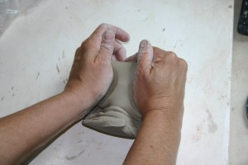
The goal of Idea Shaping is to do just enough analysis to determine the over-arching parameters of an upcoming initiative
Goal: Co-create and socialize the key building blocks of an initiative (Customers, Problems, Features, Value, Cost, Effort) with all stake holders and participating people
Key Activities
Build a shared understanding of the goals, problems, and customer impacts
Evaluate Solution options
Estimate likely value drivers and cost drivers
Identify and explore critical assumptions
Story Writing Related Activities
Do just enough story mapping to …
Move from an abstract idea to concrete initiative
Understand the overarching scope of an initiative
Identify an initial list of increments that can be delivered to end users
Collaborate with engineering to provide an initial size estimate for each increment
Other Helpful Agile Artifacts
Opportunity Canvas
Uncertainty Kanban
Impact Map
Cost of Delay Estimation
Tip: In idea shaping you are working on an entire initiative; it is critical to avoid going to the lowest level of detail. Go wide and go shallow

Slide 24
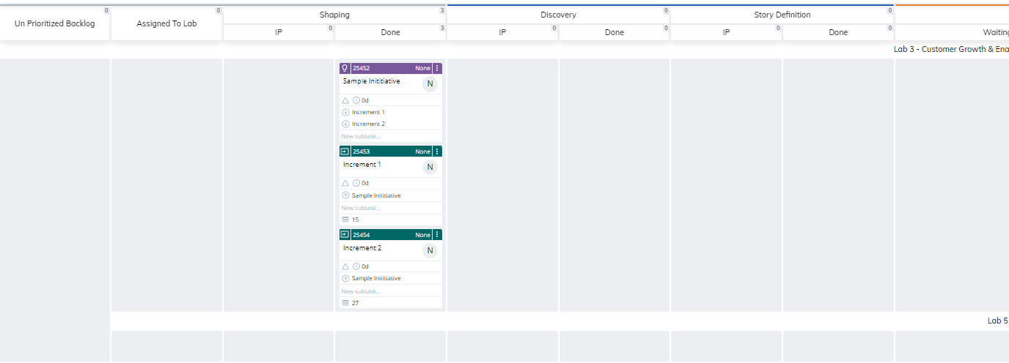
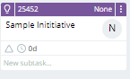
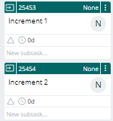
Moving an Idea / Initiative through a Delivery Kanban
1
2
3
4
1
Ideas are introduced by working with Product Managers, as well as other OLG stakeholders, Lab priority etc
Product Managers, Product Owners, and the Lab Team Members agree on which labs can initiate shaping for an idea
Labs pull in an initiative when they have capacity and do just enough story mapping to identify a set of increments that can be released to production
Increments are added to the Kanban board and the lab collaborates with technology to size each increment
The Initiative ticket and related Increment tickets are moved to shaping done
2
3
4

Slide 25
Introducing Story Mapping

Slide 26
Story Mapping is a highly collaborative practice that allow teams to iteratively identify and define the scope and priority of future state system behavior
Teams can use Story Mapping to systematically decompose an initiative into smaller units of recognizable business value, known as stories. While the practice is highly collaborative, it also lends just enough structure to focus the conversation and accelerate understanding
Persona
Unauthenticated Player
Time
Epic
Manage Shopping Cart
Feature
Shopping Cart
Login Player
Purchase with Existing Card
Submit Payment Order
Fulfill Payment Order
Story
Increment 1: Purchase Lottery Ticket via Direct Pay with an Existing Card
Add Lottery Ticket to Shopping Cart
Display Payment Options
Select Direct Pay
Prompt Player to Login
Enter Player Login Details
Authenticate Credentials
Login Player
Return to Direct Pay or MyBalance Payment Option
Retrieve Payment Options From Platform
Display Payment Options for Existing Card(s)
Submit Payment
System Generates an Order ID
Send Card Details to PaySafe
PaySafe Process Payment
PaySafe Returns Successful Payment
Select My Balance (within Wallet)
Create Player Account
Display Payment Options For Existing Cards on App
Story Mapping is…
A lightweight and semi-formal approach to defining the intended behavior of a product
A story telling vehicle; stories are arranged in a two-dimensional map resulting in a sequential narrative from left to right and a prioritization from top to bottom
A highly visible, highly sharable representation of end-to-end product scope
An accessible place where conversations are had to set and share context
A practice that intrinsically supports iterative delivery and product decomposition
Increment 2: Purchase Lottery Ticket via Direct Pay with a New Card
Priority / Optionally
Increment 3: Purchase Subscription Lottery Ticket via Direct Pay with an Existing Card
Accept Subscription Terms & Conditions
Notes:
https://miro.com/app/board/uXjVOgBcQPc=/?moveToWidget=3458764530878766430&cot=14

Slide 27
Story Mapping is the practice of mapping user goals to business objectives and user actions down to tangible system behaviors
Major categories of users that gain value from using the system
Persona
Customer
Sales Rep
Sales Rep
Fulfillment Vendor
Fulfillment Clerk
Network Operator
Billing Clerk
Time
Major objectives that with tangible business outcomes and real business value.
Epic
Manage Orders
Manage Fulfillment
Manage Provisioning
Manage Activation and Billing
The persona and story layer are the good / bits; the stuff in between is for context, the number of levels and labels will vary
Tangible, sequential events that describe what the user needs to do in order to get value
Feature
Enter Order
Process Order
Process Fulfillment Order
Submit to Fulfillment Vendor
Track Shipping Progress
…
…
Small, concrete units of business value that are also the smallest increment of delivery, typically taking several business days to deliver
We prioritize stories by ordering them vertically on the map
Story
Enter Order Info
Submit Order
Receive Order
Submit Fulfillment Order
Receive Fulfillment Order
Save Fulfillment Order
Transform to Vendor Fulfillment
Submit Fulfillment to Vendor
Receive Shipping Notification
Submit Provision Request
.
.
.
.
.
.
View Order
Submit Order with Accessory
Process Order Exceptions
Notify Customer
Process Fulfillment Order Exception
Update Order Info
Update Order Info
Notify Customer
Save Order Info
Submit Order with Features
Submit Fulfillment to Network Managmt
Process Shipping Exceptions
Optional
Update Order Info
Resend Fulfillment to Vendor
Add Accessory
Add Optional Mobile Features
Sequential
Notes:
https://miro.com/app/board/uXjVOgBcQPc=/?moveToWidget=3458764530878766430&cot=14
“Themes”
Over arching business capability or long lived business process
e.g. Go to work

Slide 28

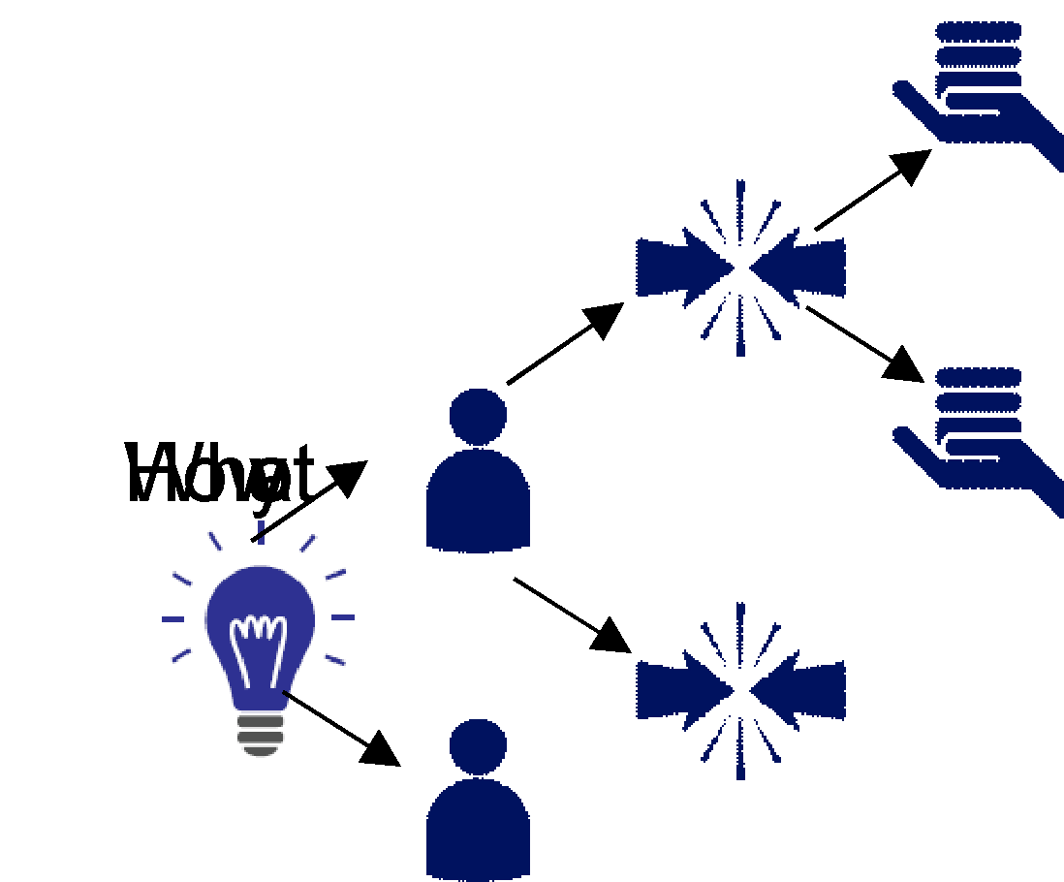
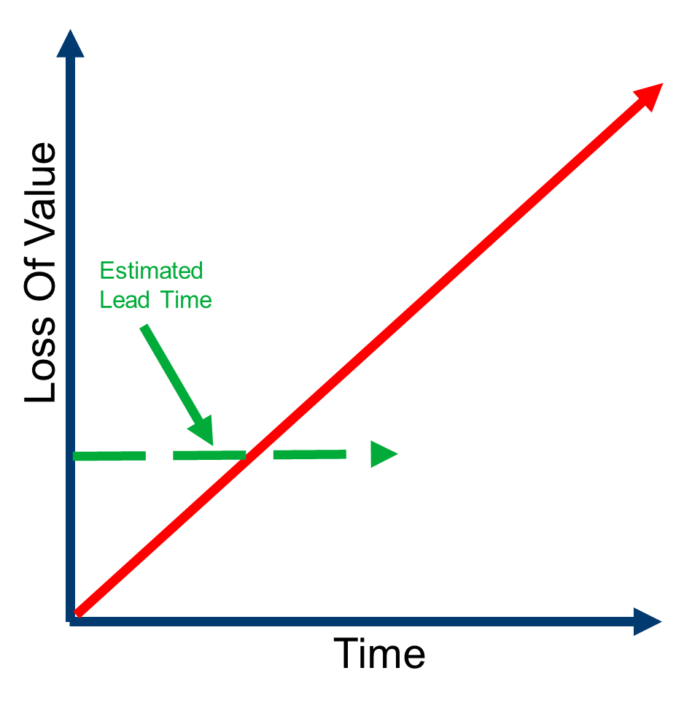
Shaping is often done in tandem with other agile practices, choose what you want to use in order accelerate shaping of ideas
Complex and Ambiguous
Epic 1
Epic 2
Opportunity Canvas
Feature 1
Feature 2
Feature 3
Feature 4
Feature 5
Story
Story
Story
Story
Story
Story
Story
Story
Story
Story
Highly Uncertain
Story
Story
Story
Story
Story
Story
Story
Story
Impact Mapping
Story
Story
Story
Story
Story
Story
Fine Grained or Well Scoped
Story
Cost of Delay based prioritization
Story
Why Are We doing This?
Customers and User Problems
Solutions and Features
Value Drivers
What are we doing?
Users Outcomes, Goals, Activities
Increments and Priority
System Behavior
Notes:
https://miro.com/app/board/uXjVOgBcQPc=/?moveToWidget=3458764530878766430&cot=14

Slide 29
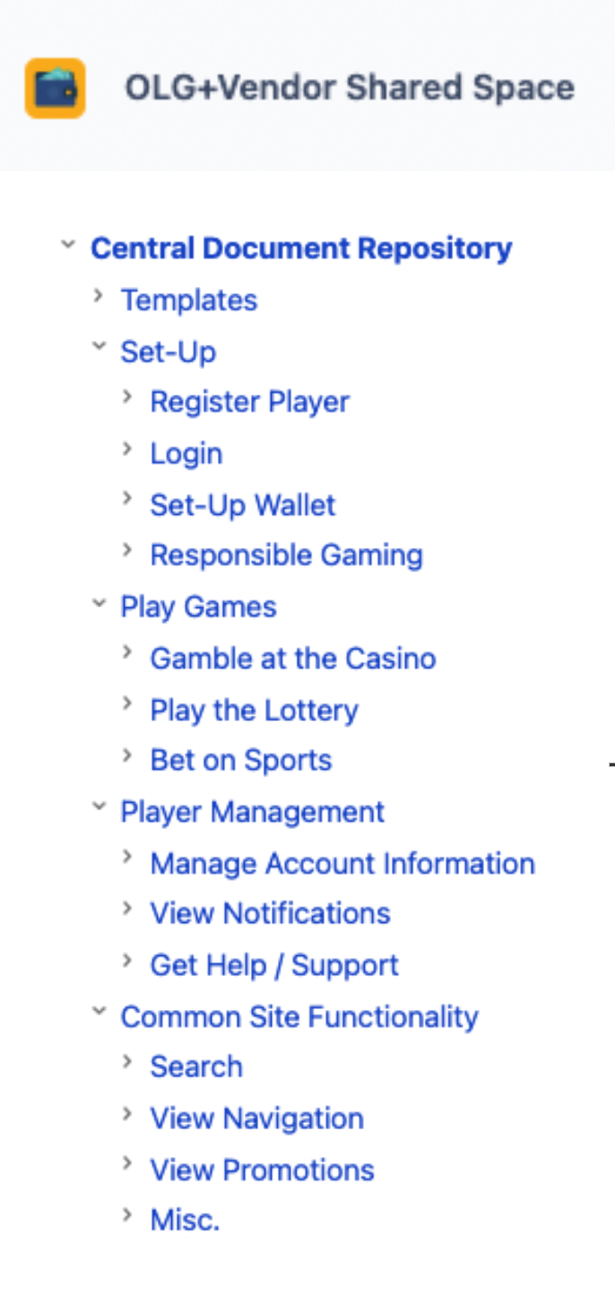
Don’t start your story map from scratch! The Story Repository can help you get started
https://miro.com/app/board/uXjVOgBcQPc=/?moveToWidget=3458764531806338225&cot=14
Confluence Hierarchy: https://federation.atlassian.net/wiki/spaces/OS/pages/184877216/Central+Document+Repository
Notes:
https://miro.com/app/board/uXjVOgBcQPc=/?moveToWidget=3458764531806338225&cot=14
https://federation.atlassian.net/wiki/spaces/OS/pages/184877216/Central+Document+Repository

Slide 30
Exercise: Take a moderately complex initiative, and start to lay it out using a story map
Persona
Think hierarchically from your users to major business goals, user events, all the way to small & observable system behaviors
Start top-down or bottom up, whatever is easier to start
Move left-to-right or up-and-down; wherever your discussion takes you
Go beyond your external users and consider administrators, support people, operational users, power users, etc…
Think about all the required functionality, customer onboarding, product setup, onboarding
Epic
Feature
Story
Optional
Sequential
Don’t forget to move your Initiative ticket to Shaping In Progress on your Kanban Board….

Slide 31

When teams participate in Story Mapping, they are exploring the unknown terrain of future outcomes and corresponding system behavior
Like exploring a new body of land, we often start by understanding the boundaries of the thing we want to better understand
At any point we may uncover an entry point or other interesting detail
Exploration requires us to continually decide whether we continue to map the surrounding edges or to go inland and get a deeper understanding of internal terrain
In both cases mapping requires us to both document what we have discovered as well as extrapolate those findings to guess at the more complete picture
The metaphor of exploration and discovery is a powerful one, and is essential to successfully mapping out the relationship between user needs and potential solution features

Slide 32
Deciding when to dive deeper, continue mapping at the current level, or to extrapolate and move on is as much art as it is science
Assigned To Lab
Extrapolate
Idea Shaping
Explore
Do we know who can take this further?
Estimate
Increment
Increment Discovery
Increment
Increment
What is the order of magnitude scope and priority of execution?
Increment
Increment
Story Grooming
Increment
What solutions will be used to deliver which features, and what is the complexity?
Epic
Tip: Complete only as much of the story map as you need to uncover uncertainty, validate assumptions and share understanding
Feature
Stories
What needs to be delivered next?
Guess the story complexity based on experience from similar work.
Conduct a cursory scan to evaluate breadth and approach. Continue to rely on past experience to inform complexity
Notes:
Assigned to lab - Do barely enough analysis to assign the idea to a lab for further shaping
Idea Shaping - Conduct a cursory scan to evaluate breadth of scope and priority. Use past experience to inform complexity and effort
Increment Discovery - Detail out the majority of stories for the next increment being delivered. Do targeted drill downs on future increments to evaluate anticipated areas of risk and complexity
Story Grooming - Detail the acceptance criteria for next feature that will be delivered.
Validate emergent uncertainty through further targeted and more detailed drill downs of future scope

Slide 33
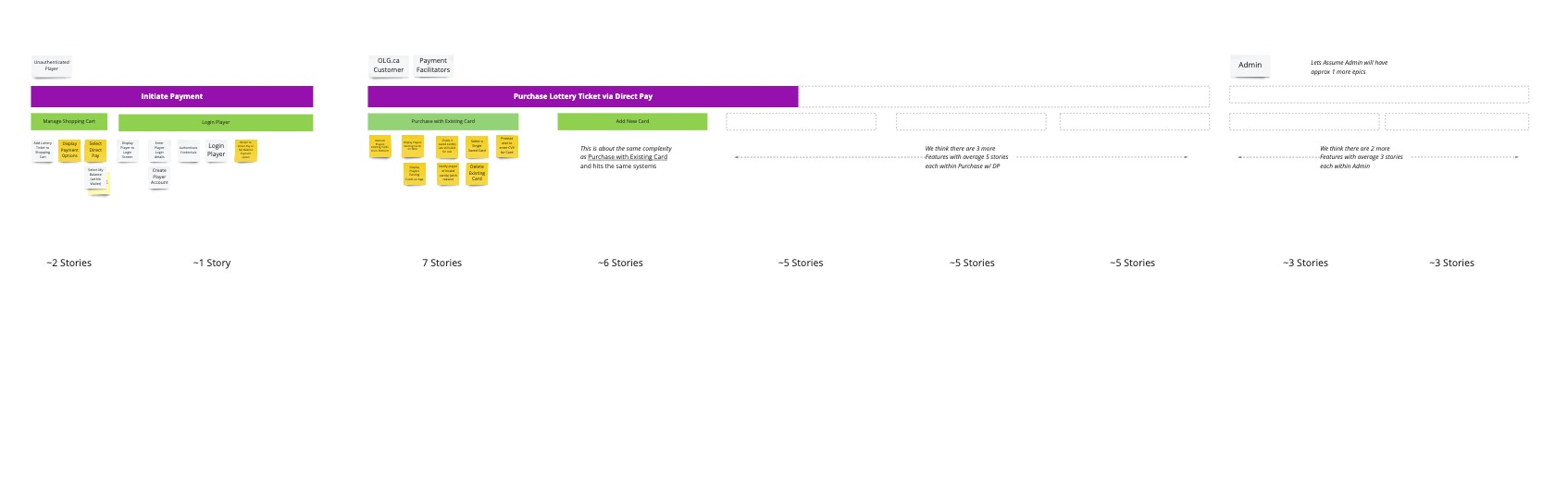
Example Story Map with Exploration and Extrapolate Annotations – Direct Pay
https://miro.com/app/board/uXjVOgBcQPc=/?moveToWidget=3458764532901466040&cot=14
Notes:
https://miro.com/app/board/uXjVOgBcQPc=/?moveToWidget=3458764532901466040&cot=14

Slide 34
Exercise: Identify areas where you need further exploration and then extrapolate the stories required to estimate the total volume of stories
Epics have between 3 and 5 features each, we have mapped 2 epics, and we have 5 more epics to map, we think there are 20 more features to cover off the entire system
This part of the system requires tech we have never used before; let's do some more mapping to better understand the complexity
Features are averaging about 12 stories per feature lets just call it 15 stories per feature for now
We detailed 6 stories in this feature, only covering basic functionality
Likely there will be 10 more stories to cover things like exception flows and other optional scope
Go through your Story Map
Identify areas where you can extrapolate
Do this at all levels of the story map, epic, feature, or story
Identify areas where more exploration is required, that will serve as a reminder for us later in the course to start here!
annotate the map with assumptions and questions
Add the estimated Story Count to your initiative on your Kanban

Slide 35
Identifying Marketable Increments of Value

Slide 36
My brilliant idea will make us millions
“
We need to build the best performance car the world has seen using the latest (maybe even experimental) technology
“
36

Slide 37
What does your customer want?
“
A
B
I just need to get from point A to B as fast as possible
“
A
A
I want to drive around town in my nice car and show off
B
A
“
C
I need to drive around town and make many stops along the way
D
Notes:
Quote Henry Ford; don’t really believe it at face value; It’s easy for users and customers to tell you what they want, what issues they’re trying to solve – sometimes they’ll even tell you how to solve it! MVPs actually help you figure what your customers need.

Slide 38
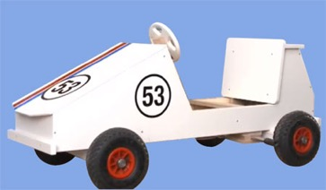
A Minimum Viable Product is a mechanism to help you understand what customers actually need
Continue to iterate based on feedback and learning
Start with a minimum viable product
Get user, customer and market feedback
Deliver 80% of the value sooner
An MVP includes just enough valuable functionality to be released into the market
We want to get the product into the customers’ hands as soon as possible, measure their response and use that data to inform the choice of what we work on next
By taking this approach, we can become customer feedback driven and deliver value to customers frequently
An MVP allows you to test an idea by releasing a set of features (early in your product and/or service’s lifecycle) to targeted users and customers, in order to collect the relevant data, and to learn from it.
Notes:
Test ideas and assumptions about what you know about the problem, market and customers – never assume that your customers know exactly what they need. Use MVPs to get market feedback; there will almost certainly be limitations with your first MVP that will be addressed with the next one – that’s OK. Just from personal experience, the most useful feedback comes from people who have actually used a product.
Keeping with the example of cars:
Start with a soapbox car – no engine, no suspension, wooden frame, but will get my customers from point A to B
Feedback: Not comfortable, I can’t carry a passenger, I need a downhill between point A and B, no storage for my golf clubs
Use feedback and research to upgrade the components, add suspension, add an engine and an extra seat
Feedback: I get soaked when it rains, still not exactly street legal, no storage for my groceries, can’t use it on highways
Again use feedback to address the common problems your customers have and use research and insight to innovate; what you end up with is a shorter overall life-cycle for delivering 80% of the value. The hyper-car was never really needed.

Slide 39


Delivering Minimum Viable Products Implies We Are Ready to Adopt Rapid Market Learning
Minimal Viable Product
(Minimal Viable) Market Increment
Smallest increment that can enable us to learn whether we have a viable product for a highly uncertain market
Primarily defined as an increment of learning
Includes a formal hypothesis and how we are going to test that hypothesis
We test the market reaction of every increment we deploy and are ready to pivot to a new direction if required
If we are not ready to adopt rapid market learning, we may want to avoid MVP terminology
A small increment of value that we (hopefully) introduce to the market and learn from
Primarily defined as an increment of scope
Less formal hypothesis, market testing, and expectations of pivoting based on market reaction
Critical to getting feedback from stake-holders and sponsors on whether we have built a solution that meets their expectations, known or otherwise
Delivering in small increment is a good first step towards higher quality delivery and accelerated market learning
During this course we will use the terminology of increments, and how to deliver them more frequently to our users

Slide 40
A Market Increment should be defined with the goal of realizing business benefits and/or validating key risks and assumptions
Business Value
Provide Mobile Service To Telephone and Cable Customers
Overall Business Goal
Business Risk
Technical Risk
Market Increment 1
Market Increment 2
Market Increment 3
Internal Employee Trial 1
100 employees
Activate inside WAN
Manual processes
No support tooling
Internal Employee Trial 2
All employees in Major City
Partial automation of provisioning
Activate over 3G network
Support through DB views
Full Customer Rollout
High and order entry UI
3 million customers
Fully automated
Robust support tooling
Business Value:
N/A
Business Value:
Build eager adopter community to promote product
Business Value:
Increase revenue stream through new service
Business Risk:
Demonstrate capability to build a viable solution
Business Risk:
Prove base product and partner integration before expanding into paying customers
Business Risk:
Validate pricing and optimize operating costs
Technical Risk:
Provisioning and activation of unproven network elements
Technical Risk:
Scaling the solution to meet higher volumes and supporting the users
Technical Risk:
Scaling operations and support to meet production usage volumes

Slide 41

Prioritizing Market Increments needs to account for a combination of value, complexity, and risk
The following factors should be considered when prioritizing work into Markets Increments:
The business value of the Increment
The effort of developing the Increment
The amount of learning that will be gained
The amount of risk & uncertainty removed
The order of dependencies across your Increments
Defining Increments tends be a process that is started by Product Owner and Analysts but requires significant co-creation from technology and operations before it can be finished!

Slide 42
When delivering larger solution, use splitting patterns to reduce the complexity and size of your Market Increments
Users:
Can the MVP be targeted at users that are grouped by role and/or context?
E.g. Tablet app for store associates
Data Variations:
Can you process one kind of data first and other kinds later?
E.g. New offer with monitoring only on redemption rate
Workflow:
Does the MVP describe a series of actions or variations in workflow that can be implemented independently? Can you implement a simple workflow before a complex variant?
E.g. New card product that only notifies successful applicants
Environment:
Where will this capability be used? What technologies and physical means will be used to deliver the capability?
E.g. Marketing campaign aimed at increasing out-of-store spend
Interfaces:
Does the user interact with the MVP in different ways?
E.g. New card product where customers can only hear about, sign up for, and get service online
Subjective Quality:
Does the MVP’s complexity depend on meeting non-functional requirements (performance, amount of visual polish, ease of use)?
E.g. New card product for 50 early adopters
Business Rule Variations:
What constraints need to be implemented within the capability?
E.g. New card product with limited set of fraud rules
Uncertainty:
When all else fails, break out a spike (extremely rough implementation that is thrown away after getting desired learning)

Slide 43
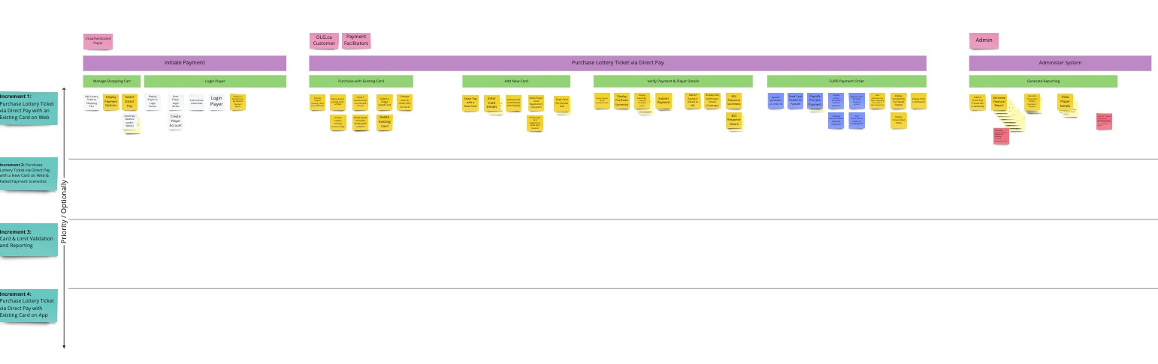
Story Map with Increments Tagged on the Side – Example Direct Pay
https://miro.com/app/board/uXjVOgBcQPc=/?moveToWidget=3458764531896784002&cot=14
Notes:
https://miro.com/app/board/uXjVOgBcQPc=/?moveToWidget=3458764531896784002&cot=14
https://miro.com/app/board/uXjVOgBcQPc=/?moveToWidget=3458764531874045593&cot=14

Slide 44
Exercise: Define A Set Of Increments for the Scope of the Solution Defined On Your Story Map
Think of how you can bring the solution to market in smaller units
Prioritize according to a combination of business value, risk, effort, and uncertainty
Leverage the Splitting Patterns if stuck on how to split work into smaller increments
Make sure to define the purpose of each market increment, the value, and any risks you will validate, and learning achieved
Don’t forget to create increment tickets and link them to your Initiative ticket.

Slide 45
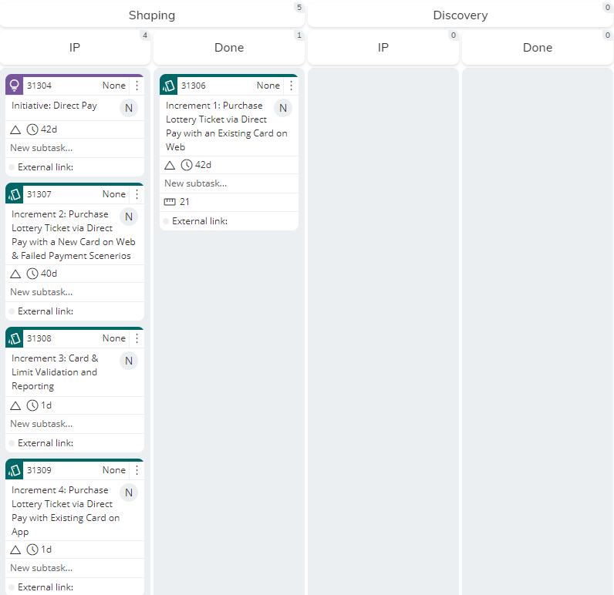
Kanbanize Example After Shaping Increment 1 – Direct Pay
What would Kanbanize look like?
https://olg3d.kanbanize.com/ctrl_board/89/locatecard/31315
Notes:
https://olg3d.kanbanize.com/ctrl_board/89/locatecard/31315

Slide 46
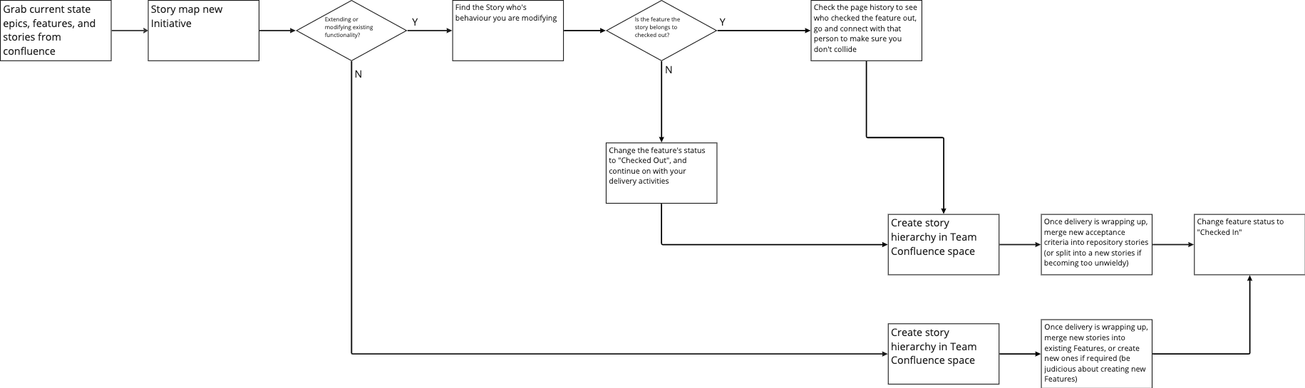
Reduce Collisions with other labs by looking in the Global Story Repository
https://miro.com/app/board/uXjVOgBcQPc=/?moveToWidget=3458764531807770936&cot=14
Notes:
https://miro.com/app/board/uXjVOgBcQPc=/?moveToWidget=3458764531807770936&cot=14

Slide 47
Discovering Your Next Market Increment

Slide 48
Discovery In A Nutshell

Slide 49

The goal of Discovery is to map the scope and work required to deliver on the next increment of value
Goal: Align on the solution and scope of functionality in a way that fosters fine-grained and incremental learning and delivery of the next end to end slice of value
Key Activities
Key functionality & solution agreed to sufficient to make any hard to reverse decisions (platform, hardware, vendors etc)
Define a plan expressed as throughput, lead-time, and batch size across the delivery lifecycle required to deliver
Agree on the likely team composition and size required to deliver
Story Writing Related Activities
Scope, prioritize and schedule your next market increment of an initiative
Complete the Story Map for an increment identifying all required epics, features, and stories
Refine / split stories based on technical / platform concerns
Features are schedule and prioritize based on team(s) estimated throughput
Other Helpful Agile Artifacts
Agile Backlog
Cumulative Flow Diagram
Domain Driven Design
UX (Lo – Fi)
Tip: In discovery you are working across a single increment, while you want to be complete from a story mapping perspective avoid detailing out each individual story
Goal:

Slide 50
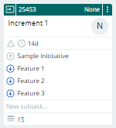
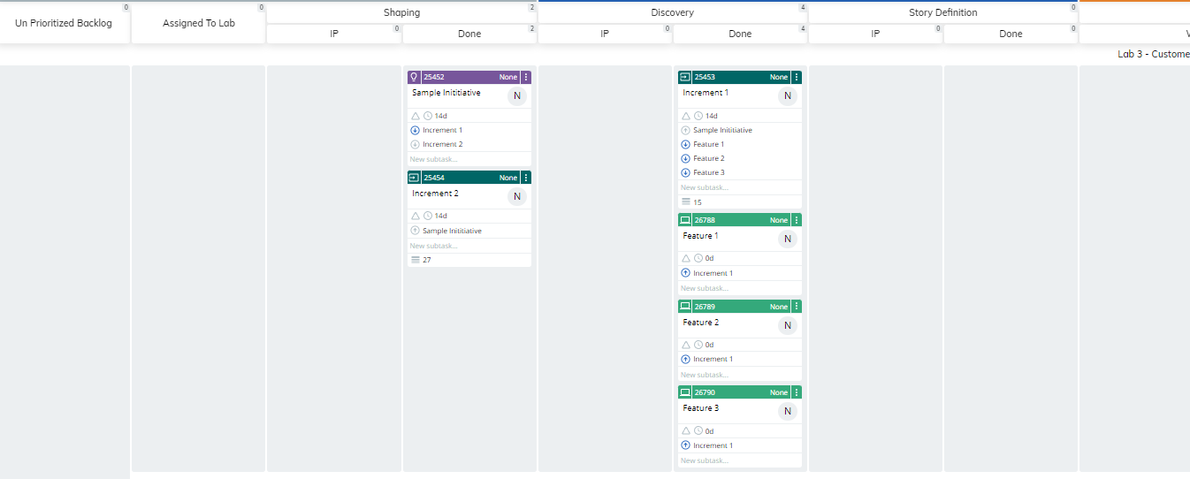
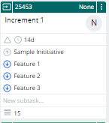
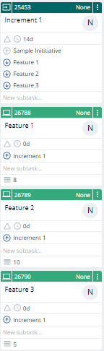
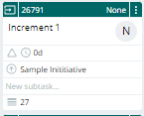
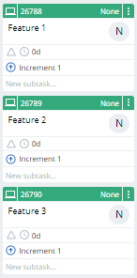
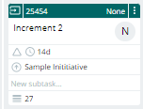
Moving an Idea / Initiative through a Delivery Kanban
3
1
2
1
A Lab pulls in the next increment of value into discovery and completes the story map for that increment
As all the stories are identified for a feature, feature cards are created as children of the increment card and moved to discovery done.
Product, Analysts and Tech collaborate to ensure all features have accurate story counts
Once all features for an increment are complete the increment ticket is moved to done in priority order
2
3

Slide 51
Refining Marketable Increments of Value On Your Story Map

Slide 52

When developing a product iteratively, start from the spine and then work your way outward
Avoid building all of one function and then building all of the next function and the function that, instead incrementally build an end to end product after every iteration
This does not mean that you will have a strictly complete product at the end of every increment rather you have some that can achieve your user’s needs and goals
To do this you start by defining the spine of your solution, a simple, rough, even manual in solution in places, anything than can even remotely be considered optional is jettisoned
Rather than reports, you expose a database table, bare bones UI over fancy screens, validation is left out
If you ran out of money next week, what would you deliver next?
If all you had was time to deliver your spine, what would you deliver to support your business outcome?

Slide 53
As we complete the Story Map for an Increment, we can start becoming more formal in laying out sequential vs optional functionality
Lay out stories vertically to represent choices users can make
Think about which option is mandatory in the sense that the solution wouldn’t work without that story
Lay out stories horizontally to indicate a linear sequence of activity
Manage Orders
Manage Fulfillment
…
…
Enter Order
Process Order
Process Fulfillment Order
Submit to Fulfillment Vendor
Track Shipping Progress
…
Sequential
Enter Order Info
Submit Order
Receive Order
Submit Fulfillment Order
Receive Fulfillment Order
Save Fulfillment Order
Transform to Vendor Fulfillment
Submit Fulfillment to Vendor
Receive Shipping Notification
Submit Provision Request
.
.
.
Increment 1
Save Order Info
Process Order Exceptions
Process Fulfillment Order Exception
Process Shipping Exceptions
Optional
Optional
Optional
View Order
Fix Fulfillment Order
Fix Shipment Order
…
Increment 2
Increment N
Notes:
https://miro.com/app/board/uXjVOgBcQPc=/?moveToWidget=3458764531874045593&cot=14

Slide 54
Story Maps are a visual medium that makes it easy to collaboratively sort your stories into order of delivery priority and identify the spine of your solution
Time
Reshuffle stories and stack them vertically according to priority order
Stories that are required to create your first increment are placed at the top of the stack, this is known as the spine
Stories that may be delivered later (and sometimes never) are placed lower, and lower down the stack
Be critical about what is in your spine, and drop anything that is absolutely not essential
Manage Orders
Manage Fulfillment
…
Enter Order
Process Order
Process Fulfillment Order
Submit to Fulfillment Vendor
Track Shipping Progress
…
Enter Order Info
Submit Order
Receive Order
Submit Fulfillment Order
Receive Fulfillment Order
Save Fulfillment Order
Transform to Vendor Fulfillment
Submit Fulfillment to Vendor
Receive Shipping Notification
Submit Provision Request
The Spine
.
.
.
Shuffle
View Order
Submit Order with Accessory
Process Order Exceptions
Notify Customer
Process Fulfillment Order Exception
Update Order Info
Update Order Info
Notify Customer
Save Order Info
Submit Order with Features
Shuffle
Submit Fulfillment to Network Managmt
Process Shipping Exceptions
Priority
Update Order Info
Resend Fulfillment to Vendor
Shuffle
Add Accessory
Add Optional Mobile Features
Exercise: Reorder the stories in your story map according to priority and identify the stories that make up your spine
Notes:
https://miro.com/app/board/uXjVOgBcQPc=/?moveToWidget=3458764531874045593&cot=14

Slide 55
As priority becomes clearer, you can revisit your market increments, placing the exact stories you want into your first and subsequent increment
Manage Orders
Manage Fulfillment
…
By dividing the entire Story Map into planned increments. We can visually tell a narrative for a particular increment.
We can also tell the story of how we want to order delivery to market.
Teams often build the story map iteratively, focusing on laying out stories for the next one or two increments at a time
Enter Order
Process Order
Process Fulfillment Order
Submit to Fulfillment Vendor
Track Shipping Progress
…
Increment 1: Basic order entry integrated with manual provisioning
Enter Order Info
Submit Order
Receive Order
Submit Fulfillment Order
Receive Fulfillment Order
Save Fulfillment Order
Transform to Vendor Fulfillment
Submit Fulfillment to Vendor
Receive Shipping Notification
Submit Provision Request
.
.
.
Increment 2: order tracking, automated customer notifications and robust exception handling
Save Order Info
Process Order Exceptions
Notify Customer
Process Fulfillment Order Exception
Update Order Info
Update Order Info
Notify Customer
View Order
Submit Fulfillment to Network Managmt
Process Shipping Exceptions
Priority
Update Order Info
Resend Fulfillment to Vendor
Increment 3: optional mobile features (Visual Voice Mail, Premium SMS, Wi-Fi to Wireless) to customers
Add Optional Mobile Features
Submit Order with Features
Increment 4: Provide accessories and full product catalogue to customers for ordering
Add Accessory
Submit Order with Accessory
Notes:
https://miro.com/app/board/uXjVOgBcQPc=/?moveToWidget=3458764531874045593&cot=14

Slide 56
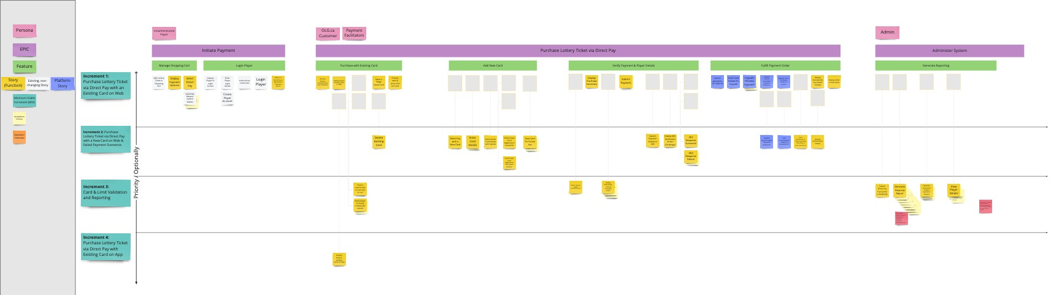
Story Map Direct Pay with increments
https://miro.com/app/board/uXjVOgBcQPc=/?moveToWidget=3458764531874045593&cot=14

Slide 57
Remember to use splitting patterns to refine the size of your Market Increments
Users:
Can the MVP be targeted at users that are grouped by role and/or context?
Eg. Tablet app for store associates
Data Variations:
Can you process one kind of data first and other kinds later?
Eg. New offer with monitoring only on redemption rate
Workflow:
Does the MVP describe a series of actions or variations in workflow that can be implemented independently? Can you implement a simple workflow before a complex variant?
Eg. New card product that only notifies successful applicants
Environment:
Where will this capability be used? What technologies and physical means will be used to deliver the capability?
Eg. Marketing campaign aimed at increasing out-of-store spend
Interfaces:
Does the user interact with the MVP in different ways?
Eg. New card product where customers can only hear about, sign up for, and get service online
Subjective Quality:
Does the MVP’s complexity depend on meeting non-functional requirements (performance, amount of visual polish, ease of use)?
Eg. New card product for 50 early adopters
Business Rule Variations:
What constraints need to be implemented within the capability?
Eg. New card product with limited set of fraud rules
Uncertainty:
When all else fails, break out a spike (extremely rough implementation that is thrown away after getting desired learning)

Slide 58
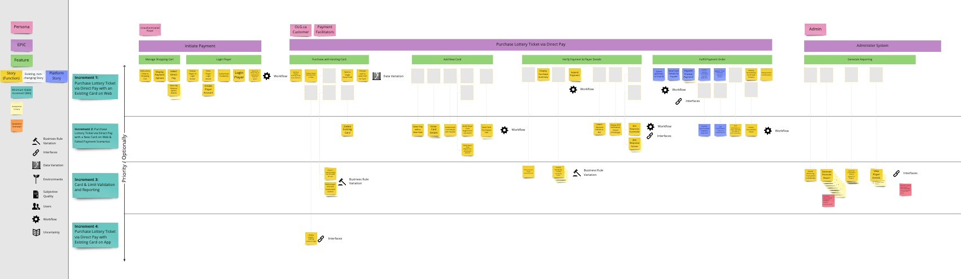
Story Map of Direct Pay Example with Splitting Patterns
https://miro.com/app/board/uXjVOgBcQPc=/?moveToWidget=3458764531897203997&cot=14
Notes:
https://miro.com/app/board/uXjVOgBcQPc=/?moveToWidget=3458764531897203997&cot=14

Slide 59

Exercise: Refine your Story Map based on scope and priority of your Market Increments
Layout your story vertically and horizontally to reflect priority and sequentially
Shuffle stories in your next increment and identify the spine of your solution
Continue to shuffle stories to refine the scope of subsequent Increments, stopping after you have defined the next one or two increments
Consider again how to use splitting patterns to refine the size of your MVPs

Slide 60

Communication and collaboration is best accomplished when we use supporting artifacts to maximize the effectiveness of a personal, face to face dialogue
Writing things down may be a required part of a knowledge worker’s job
But writing things down is far from sufficient
Written information is most effective when we add just enough structure to enable a focused conversation
Stories are semi structured artifacts that serve as a place holder to have an effective conversation
The exact amount of written detail behind a story will vary from team to team
Above all story must enable a semi structured narrative

Slide 61
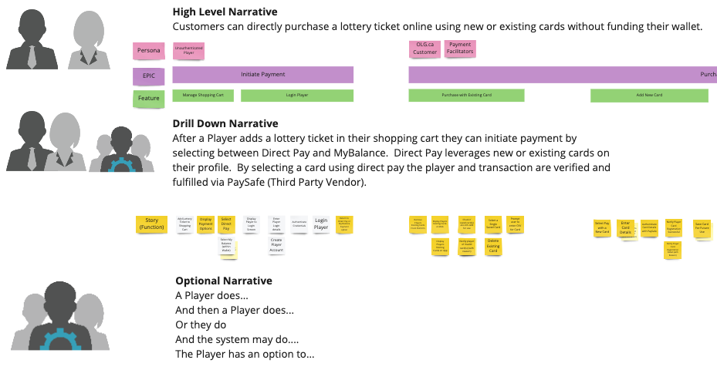
Story Mapping is primarily a vehicle that helps you tell a story about how would want users to engage with your system in the future
https://miro.com/app/board/uXjVOgBcQPc=/?moveToWidget=3458764531808236168&cot=14
Exercise : Practice story telling using your story map to help you share your narrative of future user and system behavior
Notes:
https://miro.com/app/board/uXjVOgBcQPc=/?moveToWidget=3458764531808236168&cot=14

Slide 62

As we explore our future solution, we will often encounter areas of unknowns and uncertainty that fall outside our domain of knowledge
Exploring areas outside of the team's knowledge is par for the course of most agile teams
Teams will often work outside of their expertise
When working with uncertainty it is critical that teams make note of their assumptions and take action to validate those assumptions as quickly as they can

Slide 63
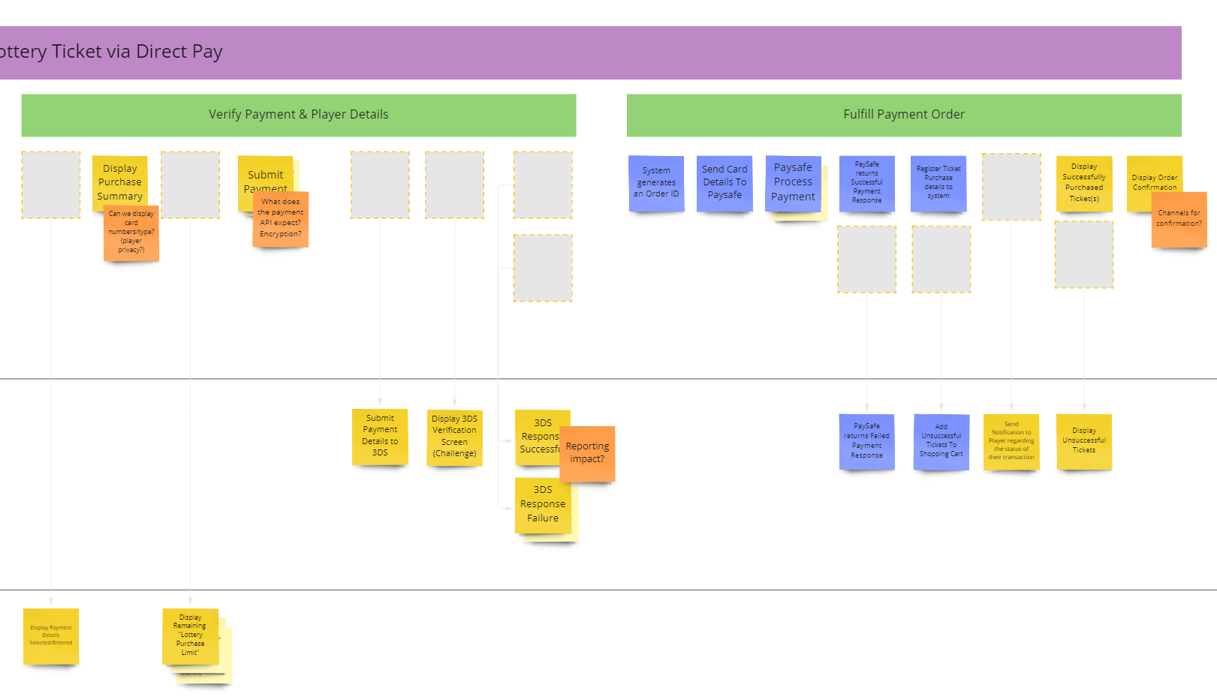
Story Map of Direct Pay with Unknowns
https://miro.com/app/board/uXjVOgBcQPc=/?moveToWidget=3458764533995948959&cot=14
In a large enterprise we can often get answers by engaging with others outside of our team
Operations, call center, senior leaders, technology, are all areas that can provide their expertise and weigh in in the feasibility of our solution in both asked for and often in areas we didn’t event to ask
Your story map is a good place to identify the need for those conversations as well as document the answers by updating he story map in real time
Exercise: Annotate your story map with which areas contain uncertainty or unknowns as and how you want reduce that uncertainty
Notes:
https://miro.com/app/board/uXjVOgBcQPc=/?moveToWidget=3458764533995948959&cot=14

Slide 64
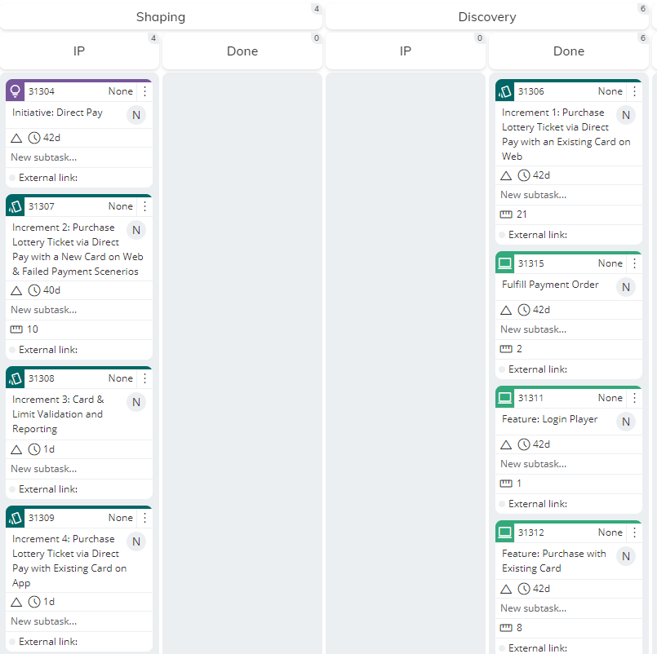
Kanban Snapshot After Discovery – Increment 1 Of Direct Pay
https://olg3d.kanbanize.com/ctrl_board/89/locatecard/31315
Notes:
https://olg3d.kanbanize.com/ctrl_board/89/locatecard/31315

Slide 65
Some Story Mapping Practices to Encourage and Avoid

Slide 66
Use Story Maps to Outline User and System Behavior *NOT* Tasks
Epic
Send Wire
Manage Wire
Feature
Avoid
Describing stories as a set of development or testing activities to be complete
Using the story map as a work breakdown structure
Encourage
Describing stories in terms of behavior the system will exhibit once a story has been promoted to production
Use the story map to describe testable increments of functionality
Benefits
Agile teams measure progress in terms of testable functionality, which enables better feedback
System Behavior conveys much more meaning that dev tasks
Behavior aligns stakeholders, technology and others outside the team
Story
Enter Beneficiary
Process Wire
…
Build beneficiary entry form
Build submission logic
Define order schema
Build processing service
Create order list dropdown
Analyze json messaging
Port 322 for async validation
Populate notify stack
Send Wire
Manage Wire
Enter Beneficiary
Process Wire
Enter Beneficiary Details
Enter Bank Details
Validate Wire Format
Submit Processed Wire
…
Retrieve Bene from List
Retrieve Bank Details
Check Fraud Wire
Notify Customer

Slide 67
Focus Story Maps on User *AND* System Activities
Epic
Feature
Send Wire
Manage Wire
Story
Avoid
Focusing only on User interactions
Black boxing system to system logic
Encourage
Define System activities, outlining the behavior required to allow information to flow across systems
Treat systems as personas, and be explicit on required back office behavior
Color code stories by system
Benefits
Focus Mapping on where complexity is in many IT projects, ie system to system behavior
Early understanding of integration points, supports placing work onto other teams backlogs
Enter Beneficiary
Process Wire
…
Enter Beneficiary Details
Enter Bank Details
Validate Wire Format
Submit Processed Wire
Retrieve Bene from List
Retrieve Bank Details
Send to Fraud
View Notification
Send Wire
Manage Wire
Enter Beneficiary
Process Wire
…
Enter Beneficiary Details
Enter Bank Details
Real time validation of bank details
Validate Wire Format
Submit Processed Wire
Transform to submission client
Retrieve Bene from List
Retrieve Bank Details
Check Fraud Wire
Notify Customer
…

Slide 68
Stories Need to Balance Being Fine-Grained As Well As Testable/Valuable
Epic
Send Wire
Feature
Avoid
Arbitrarily decomposing stories to a functional level, regardless of size
Building the map in absence of the people who can estimate the work
Encourage
Asking how “big or small are the stories in the map?” promoted to production
Breaking / Grouping stories so that most fall into a 3 – 12 day effort range
Benefits
Enable frequent feedback by decomposing the work into smaller items
Enable high quality feedback by grouping work into meaningful chunks
Story
Enter Beneficiary
…
Enter Beneficiary Details
Enter Bank Details
5d
Large story, can we break it up?
7d
Retrieve Data Details
15 D
…
Send Wire
Enter Beneficiary
…
Enter Beneficiary Details
Enter Bank Details
7d
5d
Retrieve Bene from List
Retrieve Bank Details
7d
d7
…
Epic
Feature
Story
…

Slide 69
Ground the Map in Business Language That is Specific and Precise
Epic
Feature
Send Wire
Manage Wire
Story
Avoid
Generic function, verbs, nouns
Overly technical, IT concepts, unless core to domain being discussed
Encourage
Focusing the language on the business domain
Validating that a business expert can understand the language of most of the stories
Benefits
A common artifact that serves a wide variety of stakeholders
Lightweight but precise documentation over a tome of illegible content
Enter Beneficiary
Process Wire
…
Pop Bene Core Form
Pop Bank #
Format
Submit
Get Beneficiaries
Pull Bank #
API call to Fraud
Notify
Send Wire
Manage Wire
Enter Beneficiary
Process Wire
…
Enter Beneficiary Details
Enter Bank Details
Validate Wire Format
Submit Processed Wire
Retrieve Bene from KYC List
Retrieve Bank Details
Check Fraud Wire
Notify Customer
…

Slide 70
Favor Active Behavioral Language Over Functional / Capability Breakup
Epic
Feature
Send Wire
Manage Wire
Avoid
Static functional concepts
Encourage
Verb /Noun language
Language that emphasize performing an operation on an explicit thing
Benefits
The map is easy to walk through, i.e. it tells a story
Gaps in flow make it easier to spot where the solution may be incomplete
Story
Enter Beneficiary
Process Wire
…
Order Beneficiary Details
Order Bank Details
Order Wire Format
Wire Submission
Order List
Bank Details
Order Fraud Check
Order Notification
Send Wire
Manage Wire
Enter Beneficiary
Process Wire
…
Enter Beneficiary Details
Enter Bank Details
Validate Wire Format
Submit Processed Wire
Retrieve Bene from List
Retrieve Bank Details
Fraud Check Wire
Notify Customer

Slide 71
Exercise: Go through your story map and refactor your stories to incorporate best practices
Use Story Maps to Outline User and System Behavior *NOT* Tasks
Focus Story Maps on User *AND* System Activities
Stories Need to Balance Being Fine-Grained As Well As Testable/Valuable
Ground the Map in Business Language That is Specific and Precise
Favor Active Behavioral Language Over Functional / Capability Breakup

Slide 72
Planning, Scheduling and Forecasting

Slide 73
Stories are integral part of an agile team’s ability to plan, schedule and report on progress
It a 20! Not a Story! send it back and break it up
Sprint Backlog (23 pts)
20
20
?
?
?
3
5
8
1
5
3
1
3
5
2
8
1
Team Velocity 23 pts / sprint
It a 5!
It an 8!
It a 3!
At the beginning of every sprint teams estimate stories by assigning them a point value (1,2,3,5,8,etc) representing the complexity in a story
This complexity is relative to other stories in the team’s backlog
Estimating continues until a maximum amount of work that can accomplish in a sprint is reached
Tracking is accomplished by recording how many points worth of work was done inside a sprint, known as velocity to better plan in the future

Slide 74

The Velocity and pointing approach to planning work is a good way to get teams to start collaborating in a way that increases a shared understanding of the work
Practices like sprint planning and story points are whole team activities
They are designed as activities that are done by the everyone on the team
These practices ensure that the team engage in a way that helps them challenge each other’s assumption
These practices encourage team members to challenge each other’s understanding of the work that they need to

Slide 75

Most Agile Teams eventually hit a wall when it comes to planning their work using a sprint and story based approach
Extensive data collected in the field shows that pointing based estimations and tracking of velocity is notoriously inaccurate and predictability rarely increases over time
In practice it is really hard to predict how much work is initiated and complete inside a small increment of time (eg a sprint)
The result is teams often end up padding their estimates to increase accuracy, or sacrifice accuracy to attain higher velocity
This practice is also deliberately team, development, and sprint focused which ignores the bigger picture
The biggest source of delay and churn are often outside the team, happen outside the sprint, and are not directly due to the development team

Slide 76

Like Sands in an Hourglass So Goes The Stories In Our Teams Lives
In reality we can take what works with point + sprint planning, adjust to provide both a simpler and more holistic view
Small stories let us switch from estimating the details, which is both expensive, inaccurate and myopic, to simply counting them
We estimate the story count during shaping, and then plan progress by predicting how often stories across our flow of delivery
This works because, as long as most stories are small, we can treat all stories as being effectively the same size for planning and tracking purpose, using the Law Of Large Numbers

Slide 77

Planning Is Made Simple By Calculating Throughput and Volume
A good metaphor for this kind of planning is asking how much time it would take to completely fill a bucket of water?
To calculate we an answer we simply need to understand how large the bucket of water is, and the rate the water being poured into the bucket, or the throughput
Estimating and planning is done by estimating the story volume of upcoming initiatives and their increments; then predicting what the throughput of the team is going to be and tracking what the throughput of the team has been over time

Slide 78
The Agile practice Of Relative Sizing is best conducted where size actually matters, Upstream and for larger buckets of Scope
100 Stories
88
93
At any point the work can be assessed by comparing and contrasting it to work previously completed.
As long work is similar from a platform and team perspective, than it is relatively easy to relatively size the new initiative against previously completed one
Remember as part of Idea Shaping we want to do just enough story mapping to extrapolate how many epics, feature, and stories make up an increment
75
65
47
56
23
16
20
New Initiative
10 Stories
Already Delivered Initiative
Incr. 3
25 Stories
15
In either of these stages we can relate size our increments in the initiatives against each other as well as previously delivered increments of value that are similar in platform and team skills
Relative sizing at the initiative and increment level gives us an accelerated and surprisingly accurate estimate of size
Incr. 2
27
Incr. 1
During Idea Shaping and Discovery we are continually identifying and refining our Marketable Increments
20
Incr. 2
22
Incr. 3
Incr. 4
Incr. 4
15
Incr. 1
13
5
5 Stories
Increment In New Initiative
Increment Already Delivered
Notes:
- Our teams and programs we have coaches have reported up to 95% accuracy

Slide 79

Exercise: Conduct a Relative Sizing Exercise on a topic we are well versed in…
Apply relative sizing by stack ranking the following in order of size
Doberman
Chihuahua
German Shepherd
Bulldog
Great Dane
Golden Retriever
Poodle
Newfoundland
Austrian Guildenbaur

Slide 80
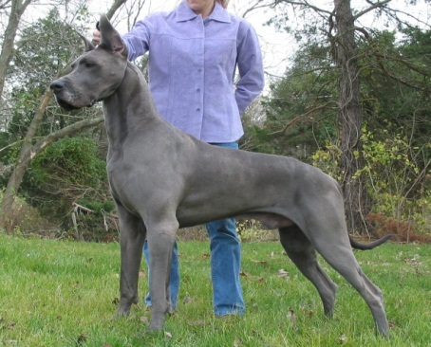

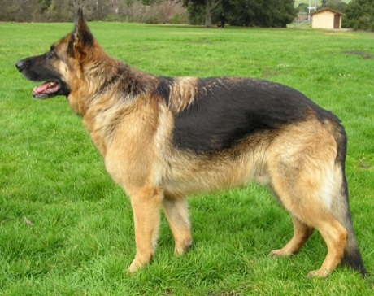
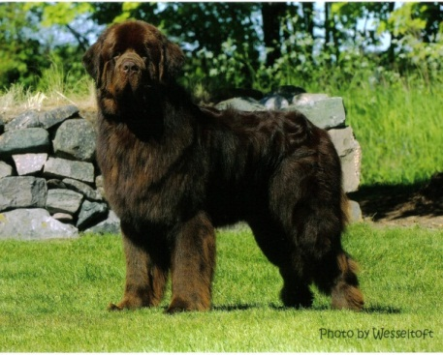


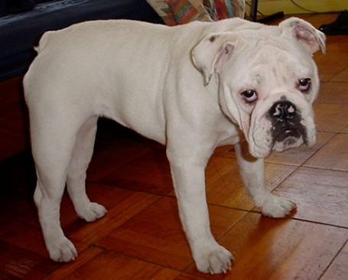

Exercise Answer:
Great Dane
Doberman
German Shepherd
Austrian Guildenbaur
Newfoundland
?
Golden Retriever
It turns out that relatively estimating known things is pretty easy to do
What about unknown item?
How would we estimate the size of the Austrian Guildenbaur?
Poodle
Bulldog
Chihuahua

Slide 81
Exercise: Conduct a Relative Sizing Exercise on your Initiative and / or The Increments inside them
1
Take an Initiative and relatively size it against previously delivered initiatives (For Bede work you may need 3 estimates: App, Web and Platform)
200 Stories
27
198
170
62
50 Stories
We did a bit of story mapping…
Let's relatively size the initiative to previous initiatives
2
Take your Increments inside an initiative and relatively size them, (Again for Bede work you may need 3 estimates: App, Web and Platform)
25 Stories
27
Incr. 3
Incr. 3
20
20
Incr. 1
Incr. 2
Incr. 2
22
15
Incr. 3
Incr. 4
We identified Market Increment…
Incr. 4
13
10
Incr. 1
Incr. 1
5
5
Lets relatively size each increment in the initiative to each other…
As well as relatively size them to previously delivered increments…

Slide 82
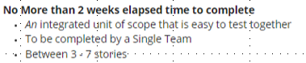
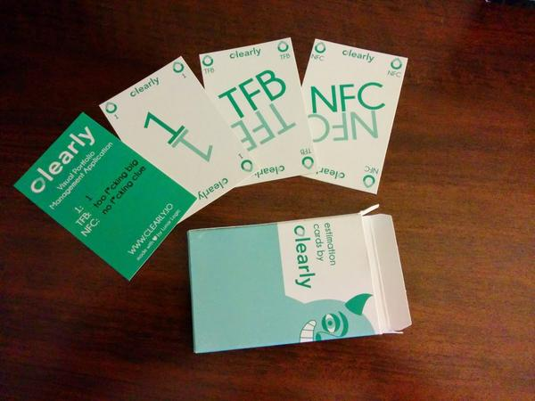
Stories throughput is a simple and easy way for agile team’s ability to plan, schedule and report on progress
No Idea
No Idea send it back for more analysis
Weekly Queue (3 Stories
Explore
It’s a story!
?
?
?
Tech
1
1
1
1
1
Quality
Team throughput 6 stories a month
Delivery
It’s too big split it up!
Product
To Big
The reality is the biggest value of pointing is ensuring that the team only accepts stories that can be completed quickly, and that stories are small
Use sprint planning and story grooming (to be covered in later in training) as an opportunity to simply reject stories that are too ambiguous, or split work into smaller stories before accepting them
By only sizing enough work based on actual throughput they keep enough work to keep the team supplied as well creating predictable performance numbers
This approach scales across the entire delivery flow as we can see the volume of planned or actual work across all states in our kanban

Slide 83
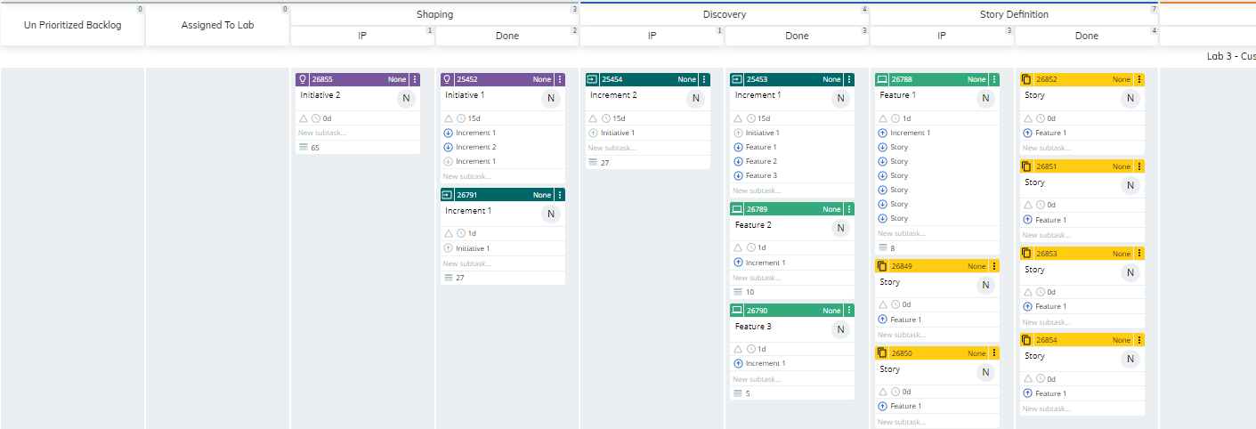

Exercise: Let’s conduct a planning experiment…
Assuming the delivery throughput is 10 stories a month, and the upstream flow can keep up with our dev teams…
Approximately when will feature 1 finish development?
Approximately when will Feature 2 start development? How long will it take to develop? How about 3?
Approximately when will Initiative 1 fully complete development? What about Initiative 2?

Slide 84

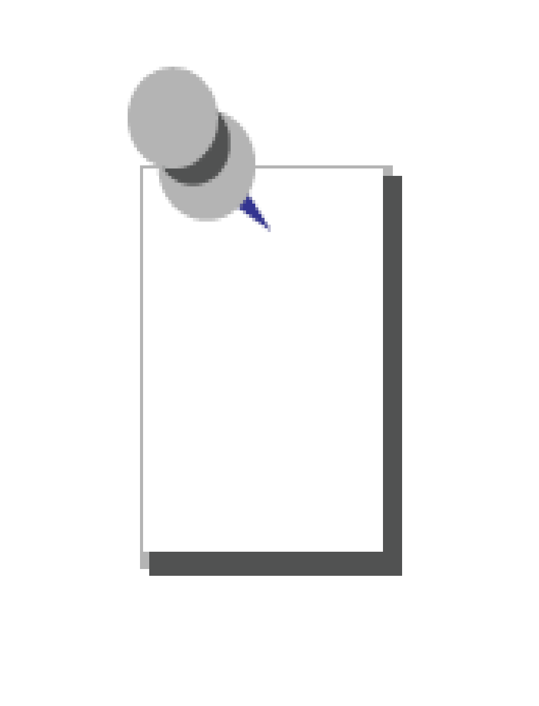
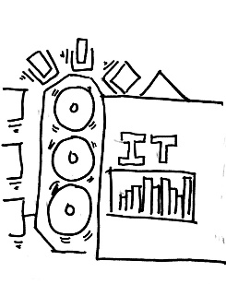



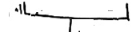



An Upstream Flow can be thought of as an Agile Backlog; where development teams can iteratively plan upcoming work
(Options)
(Shaping)
(Discovery)
(Story Definition)
As soon as an Initiative / Increment is relatively sized we can place on one or more team’s backlogs based on priority order
As the delivery start date gets closer, work will also pass through the lab’s upstream flow and be continually broken up and story counts will be refined
Schedules are Estimated by placing work into Sprint Queues that are filled until an estimated Story capacity is reached
Weeks
Weeks
Weeks
Weeks
8-12
4-6
3
2
This Week
4
10
4
7
14
3
6
4
Inspect and Adapt is used to continually adjust backlogs based on Team Throughput
24
Stories
24
Stories
12
Stories
12
Stories
12
Stories

Slide 85
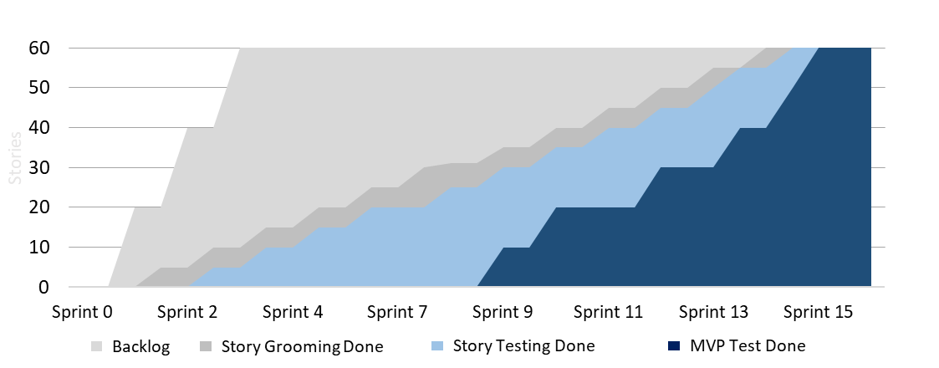
Exercise: Place relatively sized work onto one or more team's backlog
100 Stories
90
95
70
65
75
1
Finish relatively sizing your Initiative, Increments, or Features in your story map in terms of effort and complexity; guide the conversation by stack ranking them against other new items and/or previously delivered ones. Once relatively sized, we can infer a story count for each Initiative, Increment, or Feature.
50
55
New
25
15
20
Already Delivered
10 Stories
10
20
5
15
3 Mths
(30)
2 Mths
(30)
1 Mths
(30)
6 - 9 Mths
(90)
3 - 6 Mths
(90)
20
New
Plot initiatives, increments, and/or Features according to when you think the team would be able to start delivery on them (Hint: think about the team's delivery throughput).
15
20
2
Moved
15
25
30
20
15
20
45
15
3
Bonus: Try write out a prediction of how stories will flow across our system of work. Think about the cadences we can use to help us plot movement of stories (e.g. planning, story testing, integration testing) to ensure we inject sufficient feedback into the system.

Slide 86
Story Exploration

Slide 87
Story Or Not A Story! (Let’s play a little game)

Slide 88
Stories are the core artifact we use to describe how we want our system to behave in response to User activity
Independent
Recapping on Stories; Stories are
a unit of scope and value
worked on by the entire team
Statements of user and system behavior
written so they can be tested
delivered in features and increments
a place holder for conversations and collaboration
can be developed and tested in a matter of days
Describing Stories Through Acceptance Criteria
Acceptance Criteria describe the conditions that the story must meet to be accepted as complete by the Product Owner (who represents the user)
They are a way to share a clear boundary to the scope of a story, and help to describe to a team the conditions under which a story can be considered done
Are written in a behavior form or a more domain-oriented form
Negotiable
Valuable
“I N V E S T”
Estimate-able
Small
Testable
Example
Reconcile Interact and Internal Payment Transaction File and Generate Discrepancy Report
As a BCAU operator, and an Interac Operator
I want to reconcile the Interac reconciliation file with the payment center transaction record and provide a list of discrepancies
So I can fix any discrepancies that arise
Acceptance Criteria
When the daily transaction cycle is complete then the system retrieves the all transactions for the last days Interac
When the system successfully retrieves the daily transactions from Interact then the system retrieves internal transactions from the internal transaction logs and the systems compares the two transaction records
When discrepancies are found then the system creates a report that contain entries for each discrepancy and alerts User ABC
Each discrepancy entry includes both transactions, as well as the discrepancy descriptor, a …

Slide 89
COMPARISON #1
Best Practices for Writing a User Story (as a.. i want.. so that.. uggghh so dumb)
Story A
Story B
Independent
As a customer,
I want to be able to make a stock watch list
So that I can observe the change in stock prices and validate my investment ideas.
Acceptance Criteria:
Stock list creation takes less than 10 seconds
Colours should designate stocks rising and falling
As a customer,
I want to be able to make a stock watch list that is colourful
So that stocks are easily grouped together.
Acceptance Criteria:
Stock list is easy to create
Negotiable
Valuable
Estimate
Small
Testable

Slide 90
COMPARISON #1 – And the winner is…..
Best Practices for Writing a User Story (as a.. i want.. so that.. uggghh so dumb)
Story A
Story B
Independent
As a customer,
I want to be able to make a stock watch list
So that I can observe the change in stock prices and validate my investment ideas.
Acceptance Criteria:
Stock list creation takes less than 10 seconds
Colours should designate stocks rising and falling
As a customer,
I want to be able to make a stock watch list that is colourful
So that stocks are easily grouped together.
Acceptance Criteria:
Stock list is easy to create
Negotiable
Valuable
Estimate
Small
Testable
Story B uses ambiguous language such as easily, as well as some acceptance criteria in the story itself. Story A offers a little more detail with a more structured, achievable outcome.

Slide 91
COMPARISON #2
Story A
Story B
Independent
As a tester,
I want to test the submit payment function
So that there are no defects
Acceptance Criteria:
No Sev1 / Sev2 defects
All test cases executed
Test report completed and archived
As a customer,
I want to enter & submit my payment information
So that I may buy a stock
Acceptance Criteria:
Name field displayed
Credit Card Number field displayed
Payment record present in database
Negotiable
Valuable
Estimate
Small
Testable
Several guiding principles have been established for gauging the quality of a User Story – the INVEST principles

Slide 92
COMPARISON #2 – And the winner is…..
Story A
Story B
Independent
As a tester,
I want to test the submit payment function
So that there are no defects
Acceptance Criteria:
No Sev1 / Sev2 defects
All test cases executed
Test report completed and archived
As a customer,
I want to enter & submit my payment information
So that I may buy a stock
Acceptance Criteria:
Name field displayed
Credit Card Number field displayed
Payment record present in database
Negotiable
Valuable
Estimate
Small
Testable
Story A is not valuable on its own to the end user, and a common way stories are split to achieve Small

Slide 93
COMPARISON #3
Story A
Story B
Independent
As a community bank customer with an interest in investment,
I want to receive custom alerts in a lightbox pop up format with balance, transactions, holdings, date and gains
So that I can monitor the health of my investments
Acceptance Criteria:
When the user’s investment hits a preset price point, an alert is sent to the user
As a community bank customer with an interest in investment,
I want to receive custom alerts
So that I can monitor the health of my investments.
Acceptance Criteria:
When the user’s investment hits a preset price point, an alert is sent to the user
Negotiable
Valuable
Estimate
Small
Testable
Several guiding principles have been established for gauging the quality of a User Story – the INVEST principles

Slide 94
COMPARISON #3 – And the winner is…..
Story A
Story B
Independent
As a community bank customer with an interest in investment,
I want to receive custom alerts in a lightbox pop up format with balance, transactions, holdings, date and gains
So that I can monitor the health of my investments
Acceptance Criteria:
When the user’s investment hits a preset price point, an alert is sent to the user
As a community bank customer with an interest in investment,
I want to receive custom alerts
So that I can monitor the health of my investments.
Acceptance Criteria:
When the user’s investment hits a preset price point, an alert is sent to the user
Negotiable
Valuable
Estimate
Small
Testable
Story A is over-solutioned, where Story B offers enough specifics for the team to creatively develop a solution around it.

Slide 95
COMPARISON #4
Story A
Story B
Independent
As an online banking customer,
I want to change my password
So that I can keep my account secure
Acceptance Criteria:
User must enter new password twice
All passwords must be obscured
New password present in user database
Session updated with new credentials
As an online banking customer,
I want to manage my account
So that I can keep my information up to date
Acceptance Criteria:
Can change password
Can update profile information
Can change statement preferences
Negotiable
Valuable
Estimate
Small
Testable
Several guiding principles have been established for gauging the quality of a User Story – the INVEST principles

Slide 96
COMPARISON #4 – And the winner is…..
Story A
Story B
As an online banking customer,
I want to change my password
So that I can keep my account secure
Acceptance Criteria:
User must enter new password twice
All passwords must be obscured
New password present in user database
Session updated with new credentials
As an online banking customer,
I want to manage my account
So that I can keep my information up to date
Acceptance Criteria:
Can change password
Can update profile information
Can change statement preferences
Independent
Negotiable
Valuable
Estimate
Small
Testable
Story B is vague and is more Epic than Story, while Story A is focused and sharp in a single area

Slide 97


A short discussion on the Agile Story Format
Be wary of using the typical preconceived agile story template without understanding its purpose
Many agile teams use the:
As A <User>
I Want To <Perform Action>
So That <I Receive Value>
This format came around in the early days of agile
In the absence of higher-level context, this format is useful to provide a reason for a system behavior to exist
The format can give the team insight into the mind of the end user, to hopefully help make better design decisions with the end user goal in mind
It also makes sure that each card represents a small change in the system's behavior
HOWEVER
This format is frequently mis-used and attempted to be applied to work that does not require any of the above outcomes to be successful
With story maps in place, many teams find the typical template to be redundant and use a simple title to convey meaning
The main focus of the story should be the acceptance criteria, the story summary is only there to provide context!
TIP: If you find yourself writing a "story" that doesn't represent a small increment of system behavior in response to an end user action STOP and consider if the work is actually a story

Slide 98
Story Exploration In A Nutshell

Slide 99

The goal of Story Exploration is to gain a deep share understanding of the outcomes and work required for the team to execute delivery activities together for a short period of time
Goal: Perform enough definition and design so that a small cross functional team collectively understands the what, the how, and the who of delivery for the next sprint (or maybe two)
Key Activities
The understanding of stories & their solution have been refined for a feature or thin slice
A subset of the team have taken ownership of delivering the work, estimated it, and committed to start in the next couple of days
Supporting design and definition activities are completed necessary to laying out how the stories will be delivered (e.g. UX, Domain Design, etc)
Story Writing Related Activities
Share a common understanding of the next feature/slide starting delivery
Define Acceptance Criteria for every story inside the next feature / slice to start
Refine / Merge/ Split stories as necessary to ensure they are expressed at a small / similar level of details
Remaining Key risks/ unknowns/ assumptions have been explored for upcoming to be delivered Stories
Other Helpful Agile Artifacts
Planning Game
UX
Architecture Modeling
Spec By Example
Domain Driven Design
Tip: In Exploration you are going relatively deep on a smallest part of the solution that you believe a team can deliver on quickly together, but keep the focus of story writing on completeness from a user / system behavior

Slide 100


3
Moving an Idea / Initiative through a Delivery Kanban
1
2
3
1
A Single feature is pulled into Exploration based on the Lab / dev team capacity
BAs collaborate closely with Product, Designers, and Tech to define and refine acceptance criteria for each story in the feature, including identifying and exploring assumptions and unknowns
Once done the feature is moved to Explore Done in The Kanban, and all stories in the feature are added to the Kanban as children of the feature; these stories are now considered ready for the team to start working on
2
3

Slide 101

Knowledge work succeeds by watching the baton, not the runner
Any athletes that run relay races will tell you it's not just about having the fastest runners; winning teams also focus on how well they pass the baton
Most work we find ourselves in is far more like a relay race than an individual sprint. We are constantly in demand from some other part of the organization, only to pass it to someone else
In relay races the receiving runner is already at full speed by the time they get the baton, the sender also ensures that the receiver doesn’t need to look behind him; the transition is seamless
In a relay race you optimize for success when you watch the baton; you don’t optimize for the individual performance of the runners, and it’s the same for our work as well!

Slide 102
We will increase in agility if we can frequently define, deliver, and test small incremental features on a frequent basis (a matter of weeks)
Discovered
Story Exploration
Story Delivery
(Spec, Dev, Test)
Feature Testing
Waiting To Release
Feature
Story
Test then release the next increment to production
We pull Features, 1 -2 at a time
We collectively define and design all of the stories in a feature
We spec, develop and test stories independently
We validate features as soon as they are ready, and catch most of our defects early
We queue features until the increment is done
Tip: Size and resize features until each features represents a tightly integrated collection of stories that can be delivered in several weeks by a single team
Story Specification Scenario
Story Specification Test case
Story Specification Test case

Slide 103

Focus Exploration on telling a more detailed narrative that spans a small grouping of stories
Many teams make the mistake of trying to figure out the detail of a particular story one at a time
But Stories do not exist in isolation, individual Stories are small segments of a larger, interlocking narrative
It is often easier to explore stories together, grouping them in a way that allows us to discuss and deliver a more integrated set of functionality than a single story
While doing this we want to keep these groupings small, so we can incrementally deliver our work and maximize feedback

Slide 104
Running a Story Exploration Session
Session Overview
Sessions are often facilitated by Product Owner or Analysts, and actively attended by relevant SMEs, and the Development / Delivery people likely to build the feature
It is recommended to pick a highly visual collaboration tool. Like physical post-its if possible or Miro if remote so that everyone can participate
Try to keep sessions under an hour to keep minds sharp
Remember not every section of the story map must be explored all at once, incorporate into your process after story mapping and execute on a pull basis
Pitfalls to Watch Out For
Analysis Paralysis - Unknowns that require input from those not present should not derail the session. Rather, capture the assumptions and validate with SMEs afterward. It’s OK to have unknowns, the point of the exercise is to surface them, judge whether they are showstoppers, and balance acceptance criteria across stories
Siloed Sessions - Performing exploration sessions without key members of the team will inevitably cause churn. Missing technical team representation will make it challenging to load balance stories. Missing SMEs will make it challenging to answer questions that have major impact on story composition
Micro Stories - Militantly breaking down stories to the point of 1 acceptance criterion per story. Breaking down work into task lists. Too much fragmentation can make it difficult to have the pieces fit together. Try to find a balance between small and valuable

Slide 105
Writing Story Acceptance Criteria

Slide 106
Two approaches to group stories together for exploration are commonly used by agile teams, choose the approach based on level of uncertainty and level of collaboration on your teams
Two approaches to group stories together for exploration are commonly used by agile teams…..
1
Take all the stories from your next MVP that all belong to the same Feature within your story Map
Define Products
Define Plans
Create Agreement for Product
Easier to manage dependencies and isolate work across team members
Enter Product Details
Define Charge Items
Define multi product
Charge Items
Define plans for product
Add base price items
Define non standard plans
Add non standard price items
Create profile for customer
Create profile for multi-account customer
2
Further thin slice your next MVP on your Story Map into Scenarios based on a particular assumption, decision, value, or risk that you want to test as an integrated group
Prove basic data model > base pricing, ordinary charge items, 1 account per customer
Define Products
Define Plans
Create Agreement for Product
Provides earlier feedback to validate the system from an end-to-end perspective
Enter Product Details
Define Charge Items
Define plans for product
Add base price items
Create profile for customer
Define multi product
Charge Items
Define non standard plans
Add non standard price items
Create profile for multi-account customer

Slide 107
Let’s walk through exploration all the Stories inside a Feature…
Key Activities
Define a group of Stories are easy to describe, deliver, and test together.
Brainstorm data, behavior, UI, rules, etc including unknowns & assumptions
Define behavioral acceptance criteria for your group of stories
Increase your understanding by defining domain-oriented acceptance criteria
Split / Merge Stories in order to ensure all stories are similarly small
(Note: these steps can be done in any order, and steps are often revisited)
Define Product
Use Product and Charge
Define Products
Configure Plans for Products
Agree to Product Plan
Conducts Chargeable Activity
Calculate
Bill

Slide 108

Often we will need to just make sense of all the possible details and permutations associated with a particular grouping of stories
The outcome of good story exploration session is a semi structured narrative that focuses on user and system behavior; it can be had for some teams to start there
Just as often we will want to jot down any information, we can get that we think would be relevant to the story or feature at hand
We are in effect mind mapping all the permutations of data, business rules, user actions, system constraints, etc that are useful to the discussion at hand.

Slide 109
The Story Map is an excellent place to start assembling all information related to set of stories in rough form
Use Product and Charge
Agree to Product Plan
Conducts Chargeable Activity
Calculate
Bill
How many Alerts do we show, when do we stop showing them?
Other key points to cover in exploration session can include
UI / free drawing
Integration
Data elements
Business rules
Testing Scenarios
Examples
Customer:
First name, MIddle initial, Last name,
Product Agreement can only be made for more active products
Chargeable Activity ->
Customer, activity type, charge, product code
Modify homepage so customers can view charging related alerts
…
Agreement: date, product, customer, etc
Activity exceeding a threshold goes to a alert queue for customers to review
Chargeable Threshold Alert -> Activities, Period, Amount, alert code
Agreement: created on product sign up
What happens when we de-activate a product
Chargeable activity: tracked for an activated product
How do we get exception from the queue over to the product web site?
What happens when we de-activate a product

Slide 110


Example: Direct Pay Story Exploration - Low Fi
https://miro.com/app/board/uXjVOgBcQPc=/?moveToWidget=3458764533998832277&cot=14
Notes:
https://miro.com/app/board/uXjVOgBcQPc=/?moveToWidget=3458764533998832277&cot=14

Slide 111
Exercise: Brainstorm Acceptance Criteria (or the details that will contribute to your acceptance criteria)
Jot down all the information we can get that we think would be relevant to the story or feature at hand
Mind map all the permutations of data, business rules, user actions, system constraints, etc that can be used form acceptance criteria
Note down any assumptions, unknowns or uncertainty and next steps to resolve them

Slide 112


As we progress we can start refining our Narrative to cover both behavioral and domain oriented acceptance criteria
Behavioral acceptance criteria
Domain acceptance criteria
Specify outcomes that result from either user action or system triggers.
Describe flow of events, actions and reactions, processes, and tasks
Behavioral acceptance criteria can often follow the form of When <trigger> then <reaction>
When a call center rep selects a waiting call request on the call center dashboard
Then the call center system will activate the call and connect it to the rep’s work station
will describe a concept according to their structure and composition,
Describe responsibilities, information, relationship with other subjects, along with rules, or constraints pertaining to a particular concept or subject
Can use the form <A Concept> <some interaction or relationship> <another Concept>
A waiting call request include the originating phone number, the wait time of the call, the IVR problem code, and grouped according to business region the caller is calling from

Slide 113

Behavioral Acceptance Criteria describe the interaction between the human and system actors that are part of your story
When writing Stories structure your narrative in a way that you are constantly shifting across the actors in your story
Think of each criteria as an opportunity to pass the ball from one actor to the next
Often you will start with a user action, then the system will respond in kind, to again be followed by another user action,
You may also be passing the ball between two or more systems that need to integrate with each other
Tip: If you are writing more than a couple of acceptance criteria for a single actor, consider revising stories to show more interplay between users and the various systems at play

Slide 114


A good way to define behavioral acceptance criteria is to add them under each Story in the story map
Use Product and Charge
Behavioral acceptance criteria in the form of When <trigger> then <outcome> facilitates our concept of passing the ball across actors.
Sometimes the ball is passed within a single when -> then
Sometimes the ball is passed when we move from one AC to the next
In either case focus on alternating when you pass or when you run with the ball
Agree to Product Plan
Conducts Chargeable Activity
Calculate
Bill
When a Customer signs up to use a Product
Then the System creates a Product Agreement
When a Customer conducts Chargeable Activity
Then the System will track that Chargeable Activity
When a Billing Period is completed
Then the System will generate a Customer Bill for all relevant Chargeable Activity
When Chargeable Activity exceeds a Chargeable Threshold
Then the System will create an Customer Alert and send it to the Customer’s Alert Queue
Pass!
When a Product Agreement is created
Then the system activates the Product for that Customer
Pass!
When a Customer requests a Customer Bill from their Product Home page
Then the system will render the Customer Bill according to their Bill Preferences
Pass!
Acceptance Criteria
Run!
When the Product is activated for the Customer
Then associated Chargeable Activity for that Customer will flagged to be tracked
When a Customer goes to their Product Home Page
Then the system shows an Alerts Summary of all Customer Alerts not yet viewed
Pass!
When a Customer select an Alert on the home Page
Then ….
Pass!

Slide 115

Example Direct Pay Story Grooming - Well Done
https://miro.com/app/board/uXjVOgBcQPc=/?moveToWidget=3458764534187884811&cot=14
Notes:
https://miro.com/app/board/uXjVOgBcQPc=/?moveToWidget=3458764534187884811&cot=14

Slide 116
Exercise: Define Behavioral Acceptance Criteria For a Single Feature
Refine your informal acceptance criteria into the more formal When… Then.. Format
Try to describe how the system will respond to User actions
Also include system to system behaviors where it makes sense
Remember to pass the ball from one actor to the next frequently

Slide 117







When everything is described in behavioral acceptance criteria we can suffer from repetition and inconsistency
Stories often get cluttered with information that applies to more than one story, epic, feature, etc
Teams end up re-iterating the same concepts over and over
When concepts cross teams this repetition gets worse and worse…
The understanding of concepts often change over time, sometime because we learn, sometimes because we forget
Different stories can end up contradicting each other, and be inconsistent in the way ideas are expressed
This gets worse as we scale, especially when more than one team is working in the same domain

Slide 118



Domain oriented acceptance criteria are good first step towards establishing a common body of knowledge known as a Ubiquitous Language
Ubiquitous Language
A rigorous, common language between developers and users
Tested through the constant dialog with domain experts
Evolved as the team’s understanding of the domain grows
Is expressed using the identical terms and concepts in…
The Model
The Conversation
And Yes, The Code
How do we want to treat Cars differently from vehicles in general?
For cars we are concerned with passengers and fuel…
Hey I think I can understand what these guys are talking about…
Historically, technology and the business have spoken entirely different languages, interfering with collaboration, blocking understanding, and impeding progress

Slide 119
A good way to define behavioral acceptance criteria is to add them under each Story in the story map
Use Product and Charge
Agree to Product Plan
Conducts Chargeable Activity
Calculate
Bill
Domain acceptance criteria describe a concept in terms of its responsibilities, information, relationship with other subjects
This helps us to increase our shared understanding of complex domains
Thinking structurally, write sentences down using the form <A Concept> <some interaction or relationship> <another Concept(s)>
In a way we are passing the ball a bit differently this time, after every behavioral acceptance criteria we can consider injecting more domain-oriented ones
Domain oriented acceptance criteria elaborate and further explain our behavioral ones
When a Customer signs up to use a Product
Then the System creates a Product Agreement
When a Customer conducts Chargeable Activity
Then the System will track that Chargeable Activity
When a Billing Period is completed
Then the System will generate a Customer Bill for all relevant Chargeable Activity
The Product Agreement lists the Terms and Conditions where the Customer can use a specific Product and be charged according to a Product Plan
Associated Chargeable Activity is identified by referring to the Type Of Chargeable Activity priced through a Price Item in the Product Plan
A Bill is calculated based on Chargeable Activity for a specific Customer within a Billing Period
When a Product Agreement is created
Then the system activates the Product for that Customer
The Type Of Chargeable Activity, the Customer, and the Billing Period is tracked
The Chargeable Activity is found by looking up the Product Plan referred to by the Customer's Product Agreement, and calculating a Charge for each Pricing Items in the Product plan
Individual Pricing Items in the Product Plan specify the specific pricing for a Types Of Chargeable Activity that the Customer may conduct
When Chargeable Activity exceeds a Chargeable Threshold ….
Then the System will create an Alert and send it to the Customer’s Alert Queue
The volume of Chargeable Activity for the Pricing Item is collected for the Type Of Chargeable Activity being priced by the Price item
When the Product is activated for the Customer
Then associated Chargeable Activity for that Customer will flagged to be tracked
When a Customer goes to their Product Home Page
Then the system shows an Alerts Summary of all Customer Alerts not yet viewed
Each Price Item will calculate a Charge
by …
Domain Acceptance Criteria
Customer Alerts are displayed on the Client’s Home Page if they are relevant to the active billing period and will include…
When a Customer requests a Customer Bill from their Product Home page
Then the system will render the Customer Bill according to their Bill Preferences

Slide 120


Example Direct Pay Story Grooming - Well Done
https://miro.com/app/board/uXjVOgBcQPc=/?moveToWidget=3458764535675399871&cot=14
Notes:
https://miro.com/app/board/uXjVOgBcQPc=/?moveToWidget=3458764534187884811&cot=14

Slide 121
Exercise: Define Domain Acceptance Criteria For a Single Feature
Go through your behavioral acceptance and identify the major concepts or subjects under discussion
For each concept identified try to describe major responsibilities, information, constraints or relationships with other concept
In general, write out statements in the very loose form of A < Concept> <some interaction or relationship> <another sub or related Concept(s)>
Think about what concepts will span multiple stories, features, increments etc and move them to a separate place, perhaps linking them to your behavioral AC

Slide 122
Refining Your Story Map during Story Exploration

Slide 123

Deeper analysis almost always requires that we refactor our initial, higher level perspectives
In order to move forward with pace in the face of uncertainty, we are always moving forward with an imperfect and incomplete understanding of what we want to accomplish
This means we will constantly be uncovering information that invalidates, at least in part, our previous understanding of what we want to accomplish
Moving forward with out of date artifacts is an example of a small leak that reduces agility, and can eventually sink the ship
Working effectively with agility means we are constantly going back and revising our original plans, scope, solution, etc.
Team navigate this reality by keeping their artifacts light weight enough so they can modify them as new ideas emerge
Tip: Use previous artifacts as a starting point for more details discussion, not a fixed constraint, and be ready to modify high level pictures based on what you have uncovered in lower level ones

Slide 124
Story Exploration is an excellent example of where we often see opportunity to revisit; Team often refine Stories in their story map to better reflect our increased understanding
Initial Story Map
Story Map with Initial Acceptance Criteria
Story Map Normalize
Our original picture of all the stories we think we need after performing discovery on an Increment
Some Stories end up being large, even massive
Some stories only have 1-2 criteria, and appear tiny
We may have orphaned acceptance criteria, we missed a story or two on our initial story map
Stories are split where necessary to ensure they can be developed and tested by a single team in a couple of days
Large enough that they capture a cohesive set of user and system behavior that can be tested by the business
We may add and/or defer some stories to a later increment

Slide 125
Exercise: Refine Your Story Map based on Story Exploration Done So Far
Go through the stories in your feature and ask what changes do you need to make in the story map?
Where can stories be split and merged?
Where do we need to add new stories or change the flow of the stories?
Where do we want to defer stories to later increments and/or identify new stories that we can deliver later?

Slide 126
Vertical Story Splitting

Slide 127
Story splitting allow teams to ensure we can inject feedback into our delivery and development activities
Top signs that you should split a story:
When a story is too big to complete within a reasonable timeframe (2 weeks is common rule of thumb)
When a story is too complex or complicated, causing a lot of questions from developers
When you want to get quick feedback from your stakeholders
When a story has a lot of dependencies (team and external)
Why bother splitting? I have all the information I need!
Small stories allow the team to fail early, and fail fast
Smaller stories enable the team to learn quickly (both technically and user experience)
Smaller stories pass more quickly through the workflow
Smaller stories have more certainty and clarity
Smaller stories make the team faster!
Story Splitting Pitfalls to watch out for:
Splitting stories horizontally first before trying to split the scope can lead to isolation of other layers and thus increase dependencies and hinder overall pace of development
Splitting stories until they become tasks and to the point that product owner does not have see any value in the “stories” at this level, and we end up with stories that are not testable by anyone other than a developer, and therefore cannot be accepted or demoed

Slide 128















Teams can leverage a number of story splitting patterns to keep stories small
Story Splitting Patterns
There are many approaches to splitting stories. We will explore a couple aiming to maintain INVEST principles via Vertical Slicing
First Story
Workflow Steps What steps does a user perform and
can I separate or simplify the steps to deliver now vs later?
Send an e-transfer to another person
select and confirm the person I am sending an e-transfer to
select the account where the money will be sent to
Receive a transaction confirmation record
Business Rules What business rules apply to this story and what can I simplify or separate business rules right now vs later?
First Story
Send a cross currency wire of < $50K using daily updated daily table
Send a cross currency wire to another entity
Send a cross currency wire of >=$50K using a live FX rate
Happy/Unhappy Path What does the happy / unhappy flow look like, can unhappy flows be simplified, separated or are they even necessary now vs later?
log in with correct credentials
First Story
Log into Bizbank
Block users with 3 failed login attempts in a row
Request a new password
Splitting on Operations What operations are involved and which of these can we separate out and consider for now vs later?
update the amount and date of an existing recurring expense
First Story
Create
Manage recurring payments
Add a new recurring payment
Delete a recurring payment
Update
Delete
Read

Slide 129
Vertical Story Splitting Patterns Cheat Sheet
1. Workflow Steps? What steps does a user perform? Can I separate/simplify steps (right now)? i.e. steps in an e-transfer, such as selecting payee, source account, confirmation receipt, etc. | 2. Business Rules? What business rules apply to this story? Can I simplify or separate business rules (right now)? i.e. failures during web order process and possible recovery options | 3. Happy/Unhappy Flow? What does the happy / unhappy flow look like? Can unhappy flows be simplified, separated or even necessary? (right now) i.e. successful login with successful known credentials. | 4. Operations? What operations does their story perform? (create, read, update, delete)? Are all operations required? (right now) i.e. Splitting on CRUD (create, read, update, delete)
5. Datatypes and Parameters? What datatypes are supported? Can I separate data types? i.e. different search options / different kinds of reports (tables, graphs. Etc) | 6. Input Option? Which platforms are supported? Are all platforms required (right now)? Are some platforms harder that others? i.e. mobile, tablet, browser, etc | 7. Test Case/Acceptance Crit. What tests are used to verify the story? What are the acceptance criteria? Can I simplify/separate the story’s acceptance Criteria (right now)? i.e. steps in an order proves, like selecting a payment option, delivery method, etc. | 8. Roles? What roles are involved in this story? Can I separate the roles and/or are all of them necessary (right now)? i.e. steps in an order proves, like selecting a payment option, delivery method, etc.

Slide 130


How Do I Know Where To Stop?
How long will the story take to develop?
2. How will we test this?
Someone who is not an engineer must be able to test the story’s behaviour (tools such as Postman, Rest Assured may be required)
In other words, try to avoid “stories” that manipulate data and variables solely in memory
Getting this under 2 weeks is a good rule of thumb, this allows you to deploy and test more frequently

Slide 131
Exercise: Revisit your stories being explored and apply vertical splitting patterns at necessary
Look at your Stories, which of these still feel too large?
When in doubt, look at number of acceptance criteria! If the list is long, really consider breaking that story up
Examine these stories and see if one or more splitting patterns apply
Alternatively, look at your acceptance criteria. Are there distinct groups within them? If so, use those boundary lines to create your new story breakdown
Remap stories and re-allocate acceptance criteria as necessary
Validate: Have we gone too far? Is this still testable from an end-user perspective?

Slide 132
Horizontal Story Splitting (Defining System Level Stories)

Slide 133

While good story writing keeps us focused on user to system interactions, sometimes we need to deeper
Sometime we are heavily challenged to come up with a small increment of team work that is a recognizable increment of user and system behavior
Perhaps the there is a large amount of back-office system to system related processes
Perhaps different portions of the user observable behavior is being developed by separate teams and you have little influence on this team structure (eg back office and front end teams)
Perhaps you have broken your architecture into discrete micro-services that are owned by discrete team and want to separate stories for each separate service
Tip: When the context asks for it, consider going below sea level and define stories and story acceptance criteria for interactions across system / technical components

Slide 134

Going below Sea Levels can dilute the value and purpose of stories; at a minimum make sure you are always using stories to describe behavior
User Story
I
N
V
E
S
T
Captures system behavior that a user can see
Have observable value to the user
Are clearly testable; we will learn something after we deliver it
Can get really large in terms of time and effort, especially for new team and/or legacy technology
Search For Account
System Story
Captures system behaviour that a crosses one or more systems/components
Use to capture cross system/component interaction.
Can have value to a Business Stakeholder if they can be bothered with system interactions
Are testable using the right tooling
Send Account Search To External Service
I
N
V
E
S
T
Avoid if at all possible!!!!
Tech Story
Captures system behaviour internal to one application layer
Not considered best practice. Tech stories will not result in user or business valued stories
Are a reasonable hack, if the team has having trouble defining user or small system stories
Must be written in a way that expresses system behavior as it will exist in production
Must still be tested by someone who is not a developer, ie BSA or QA
Must be a unit of work that the entire team collaborates on, ie Analysis > Dev > Test
Assemble Account Query
I
N
V
E
S
T
Not a story!!!!
Task
Build Account Table with Three Fields
Captures team work required to develop or test one or more stories
Does not describe any system behavior
Is not counted as a part of a teams metrics
May be visualized a Kanban or task board to help teams track and plan their work
I
N
V
E
S
T

Slide 135
Example: Store An Image
Let’s take an example of a seemingly simple story; at least from a user perspective
Warm Storage
Cold Storage
Response
Payload
Cloud Storage
System
Send To Correct Cloud Bucket
Response
Assess Storage Rules
Payload
Validate Payload
Storage Microservice
Response
Accepted Payload
Response
Send Payload
Invalid Payload
Response
Assemble Payload
Parse & Validate Scan
Image Scan
Local Mgmt System

Slide 136

User Stories Only Consider User-Visible Impact
1
2
1
User Story: Successfully Store an Image Scan
Story Summary
As a Staff user
I want to store a the scan of an image in the cloud
So that it can be accessed from any location
Acceptance Criteria
Successful transmission shows confirmation message “Image Scan Successful”
Scanned image is present in database
2
User Story: Unsuccessfully Store a Image Image
Story Summary
As a Staff user
I want to be notified if my image is not saved
So that I know to save it to the local database
Acceptance Criteria
…
…

Slide 137
System Stories Have The Same Boundaries As Systems or Components
1
System Story: Parse & Send Image
Story Summary
When the LMS receives an image scan
Then send to Storage Microservice
Acceptance Criteria
Valid scan sends payload in following format…
Any missing metadata or image sends error back to user and saves in log
3
2
System Story: Assess & Categorize Image
Story Summary
When the Storage Microservice receives an image payload
Then send to correct cloud storage bucket
Acceptance Criteria
Payloads that have a date in the last 7 days go to warm storage
All others go to cold storage
Reject any payload with missing data, send failure response back to LMS
2
3
System Story: Store Image
Story Summary
When Cloud Storage System (CSS) receives an image payload
Then store it and send confirmation
1
Acceptance Criteria
Payload with correct structure saved in table, send confirmation to Storage Microservice
Incorrect structure, send error code 1
DB not found, send error code 2, save to log
Break down the black box

Slide 138
Technical Stories Define Behaviour Internal To Systems/Components
1
Tech Story: Parse & Validate Scan
7
Story Summary
When the LMS receives an image scan
Then Validate the payload
8
Acceptance Criteria
No empty fields
Provided image hash matches actual image hash
2
Tech Story: Assemble Payload
6
Story Summary
When I receive a valid scan
Then assemble into transmission format
5
4
Acceptance Criteria
Assembled in JSON 2.3
Format and max field size is as follows:
ID | Hash | Fname | Lname
Int (16 chars) | Int (32 chars) | String (20 chars) | String (40 chars)
3
3
Tech Story: Send Payload
2
Story Summary
When I receive an assembled payload
Then transmit it to the SMS
Break down the black boxes
1
Acceptance Criteria
…
…

Slide 139
Exercise: Revisit your stories and add system and/or technical stories if (and only if) required
Look at your Stories, which stories require more than a single team to deliver on?
Which Stories are still too big from an implementation perspective?
Split these stories into system stories, and if absolutely necessary technical stories
Rewrite acceptance criteria to reflect the perspective of the system and/or technical component (hint technical team members will be required)

Slide 140
There are many more techniques and resources
Splitting User Stories Presentation: http://www.slideshare.net/arsenalist/splitting-userstories
Breaking Down Larger Stories: http://agileinaflash.blogspot.co.uk/2009/02/breaking-down-larger-stories.html
User Story Hamburger technique: https://gojko.net/2012/01/23/splitting-user-stories-the-hamburger-method/
Features to User Stories: http://idiacomputing.com/pub/UserStories.pdf
Patterns for splitting user stories: http://agileforall.com/patterns-for-splitting-user-stories/
Twenty Ways to Split Stories http://xp123.com/articles/twenty-ways-to-split-stories/
50 Quick Ideas to Improve Your User Stories https://www.amazon.ca/Fifty-Quick-Ideas-Improve-Stories-ebook/dp/B00OGT2U7M

Slide 141

Writing a Non-Functional Acceptance Criteria
Best Practices for Writing a User Story (as a.. i want.. so that.. uggghh so dumb)
Most common types of non-functional acceptance criteria for front-end development:
Performance (How fast should the page/function respond to the user?)
Security (Is there anything we shouldn’t allow for security purposes?)
Usability is also common, however usually manifests itself in the UI design instead of the Acceptance Criteria (eg. How many clicks does it take to do the task? How many seconds?)

Slide 142
Here are a few takeaways on User Stories:
Writing User Stories is one of the core competencies of an Agile Team; but remember:
Writing stories is part art, part science
There are principles to gauge story quality but there are few rules to follow when writing stories
Writing good stories is really hard! Expect the first stories you write to be poor and for quality to improve with practice
Teams will usually struggle at the beginning to break stories small enough that they can be completed in a short amount of time (ie < 2 wks)
It is important to bound the story without predetermining the solution
It takes practice to get good at writing stories
It takes even more practice to get stories right-sized
Business constraints need to be balanced against the technical solution

Slide 143

Now that you have a solid handle on stories and what goes inside them, you can create the Story and Acceptance Criteria in Confluence (and in your work management tool!)
https://federation.atlassian.net/l/cp/toYuDNyB
Notes:
https://federation.atlassian.net/l/cp/toYuDNyB

Slide 144

Kanbanize Snapshot – Post Story Exploration
Notes:
https://federation.atlassian.net/l/cp/toYuDNyB

Slide 145
Story Specification

Slide 146

Goals and Activities Of Story Specification

Slide 147
A Brief Note On Specifying One Story at a Times vs current approach of a feature at a time

Slide 148
Moving an Feature through Story Specification

Slide 149

Spec By Example – In a Nutshell
Spec by Example is A way to express complex system behaviour (in stories) in a simple, structured way
Spec By Example extends the acceptance criteria teams define by defining scenarios as well as adding real world examples to those scenarios
Spec by Example works because Humans often struggle to interpret complex concepts in the same way;
But humans are very good at deriving concepts by observing them in action
Spec By Example helps Increases team understanding, leading to faster delivery and fewer bugs
The practices helps teams spot requirement holes and edge cases before starting to code
Spec by Example has excellent integration with ATDD/BDD tools, so that examples can be plugged directly into automated tests, so that teams can rely on business rule documentation that automated, and always up to date

Slide 150
How Specs fit into Story Development
Story Exploration
All of the stories in a feature or thin slice are described using semi formal acceptance criteria
Unknowns are explored, solution feasibility, UX (lo-fi minimum) are designed, story sizes are confirmed, etc
Story Card
Story Acceptance Criteria
Spec by Example
One story is specified at a time
Acceptance Criteria are converted to multi-step scenarios by adding pre-conditions, alternate and exceptional flows, ordering steps, etc
Scenarios are extended with examples; we add data sets to that contribute to one or more test cases; forming a test suite
Story Specification Scenarios
Story Spec with Examples
Behavior Driven Development
Developers or QC write a test fixture, using a BDD tool (eg Cucumber)
Developers write code until the test pass
BA/QC perform a final verification and a quick manual test
Test Fixture
Code

Slide 151
Specification Scenarios stated simply
Given
<preconditions>
System data state before the trigger occurs
When
<trigger>
Event or action that causes behaviour
Then
<result>
System state/output afterward

Slide 152
Specification With Examples
All examples for a scenario are written to validate whether an acceptance criteria passes or fail:
Examples can include:
Various ranges and data values (boundary & corner cases)
Different business rules resulting in changes in data
Positive and negative conditions
Given
Test Case | User | Balance | Account | Contact
1 | Glenn Mendoza | $300 | Chequing | Sam Roche / USA
2 | Linda Chan | $800 | Savings | Yu Ling / China
Scenario
Given
A user is logged into his bank account
And that user has a particular ‘account balance in his account
And that user has a contact associated with his account
When
The user chooses to view contact details
Then
The debits taken from the account by that contact is displayed for the current billing period
When
Test Case | Contact
1 | Sam Roche / USA
2 | Yu Ling / China
Then
Debits
$30
$100

Slide 153
Specification Scenarios – the complete example
Provides explicit, unambiguous requirements
A scenario is an example of the system’s behavior from one or more users’ perspective
Each Acceptance Scenario is broken down into Acceptance Test case
Uses Gherkin syntax:
Feature: provide a high-level description of a software feature, and to group related scenarios
Rule: groups scenarios in a feature according to a business rule that should be implemented
Background: adds common context to multiple scenarios in the form of pre-conditions
Example / Scenario: groups multiple given, when/then statements into a common flow
Given : what must be true or present for the test case started. Focus on state or conditions not behavior from previous stories
When: the particular trigger or action that causes the scenario to start
Then: the outcome of that particular action or trigger, what must be true after the system has responded
And/But: additional context to provide further context for the feature.
But: to provide further context for the feature in negative form
* alternate form of and (for lists of items)
Feature: <story name>
Background:
Given <some precondition>
Rule: <rule that needs to be explained>
Example / Scenario:
Given <some precondition>
And <additional preconditions>
And <additional preconditions>
…
When <an action/trigger occurs>
And <additional action occurs>
…
Then <some post condition>
And <additional post conditions>
But <additional negative post conditions>

Slide 154
An Example Specification – ACME University
Story: Purchase Textbook
Given a student is logged in to the system
And a particular textbook exists
And that textbook is not out of stock
When
The student selects that textbook for purchase
And the student specifies shipping information( shipping method, billing address, shipping address )
And the student confirms his purchase
Then the system send the payment information to the 3rd party
And the system send the Order Details to the bookstore application
And a message is display to the student that the book was successfully purchased and is on its way

Slide 155








Spec By Example For an Entire Feature
Feature: Filter Active Call Center Cases
Background:

Slide 156


Walkthrough of the Specification By Example Template

Slide 157

Walkthrough of the Specification By Example Template

Slide 158
The practice of writing out examples is meant to drive automation testing
Before execution
After execution
Execute
Business user can click execute to run the test
Execute
The system is tested against the requirements
If the test passes then the requirements go green
If the test fails then the requirements go red.
Given that customer 012 has a chequing account with overdraft protection at the bank
And the account has a balance of $100
When customer 012 withdraws $50 from their account
And in a separate transaction customer 012 withdraws $60 from their account
Then after the first transaction the account has a balance of $50
And the first transaction is successful
And after the second transaction the account has a balance of -$10 and is in overdraft
And the second transaction is successful
Given that customer 012 has a chequing account with overdraft protection at the bank
And the account has a balance of $100
When customer 012 withdraws $50 from their account
And in a separate transaction customer 012 withdraws $60 from their account
Then after the first transaction the account has a balance of
And the first transaction is
And after the second transaction the account has a balance of and is
And the second transaction is
Requirements can be written in the form of a “story” using the language of the business
Other formats can be supported (i.e. use case, process, etc.)
$50
successful
$50
not in overdraft
rejected
Tips for Writing Specification By Examples
Be Precise and make the specification testable
Focus on business functionality, not design
Avoid UI details
Avoid covering every possible combination (emphasis scenarios based on risk)
Supplement with Exploratory & User Experience Testing to increase test coverage
Include non-functional scenarios (e.g. performance, load, usability, etc.) as specification by example

Slide 159
The 10 Deadly Sins of Spec By Example
No examples
Incorrect Trigger
Repetition
Using UI elements (not contents) in Given, treating as steps
Irrelevant Givens
Unreadable formatting
Exposing inner workings of the system
Imprecise Language
Doing Specs after Engineering
Overspeccing

Slide 160
Sin #1&2: No Examples, Incorrect Trigger
Use licence # to verify AB residence
Given I have searched for a client by first and last name
When a record is found
Then use licence number to verify location of residence
And display province of driver’s licence
Use licence # to verify AB residence
Given I have the following client record
And the following licence record
When I do a client search for “John Jones”
Then I should get the following result
Client ID | FName | LName | Licence #
178654 | John | Jones | 35612
Licence # | Prov
35612 | AB
Province
AB
Try to avoid simply transposing a standard acceptance criterion into Given When Then, instead show the conditions that cause the behaviour

Slide 161
Sin #3: Repetition
1. CHECK CHEQUE ID
GIVEN Cheque Image payload has been received by Hermes
WHEN Cheque ID# is NOT populated in the payload
THEN Log payload as a failure
--
2. CHECK BRANCH ID
GIVEN Cheque Image payload has been received by Hermes
WHEN Cheque ID does NOT end with the branch ID
THEN Log payload as a failure
--
3. CHECK METHOD
GIVEN Cheque Image payload has been received by Hermes
WHEN Method is NOT "scan" OR "rescan"
THEN Log payload as a failure
--
4. CHECK LANGUAGE
GIVEN Cheque Image payload has been received by Hermes
WHEN Language is NOT "en" OR "fr"
THEN Log payload as a failure
--
5. CHECK INTAKE TIMESTAMP
GIVEN Cheque Image payload has been received by Hermes
WHEN Intake timestamp does not exist
THEN Log payload as a failure
--
6. CHECK PROVINCE
GIVEN Cheque Image payload has been received by Hermes
WHEN Province is not present
THEN Log payload as a failure
No payload field may be empty
Given I have the following scanned cheque image payloads
When I import the payloads
Then I should get the following results
Cheque ID | Method | Language | Timestamp | Province
<blank> | Scan | EN | 11:12:00-03/14/2020 | ON
4269-10 | <blank> | EN | 11:12:00-03/14/2020 | ON
4269-10 | Scan | <blank> | 11:12:00-03/14/2020 | ON
4269-10 | Scan | EN | <blank> | ON
4269-10 | Scan | EN | 11:12:00-03/14/2020 | <blank>
4269-10 | Scan | EN | 11:12:00-03/14/2020 | ON
Result
Fail
Fail
Fail
Fail
Fail
Pass
Branch ID must be embedded in Cheque ID
…
Method must be scan or re-scan
…
Language must be en or fr
…

Slide 162
Sin #4: Treating Givens Like A Traditional Manual Test Case
Recurring bill payments expire after period end
Given the following recurring bill pay record exists
When I submit the following queries
Then I should get the following results
Txn ID | Acct ID | Payee ID | Period Start | Period End
777888 | 156332 | 46722 | 03/14/2020 | 01/01/2021
Recurring bill payments expire after period end
Given I log in as a user with correct permissions
And I click on the home screen
And click on the Bill Payment button
And in the payee filter field enter “CRA”
And check the Active Only option
And my recurring payment with the CRA has an end date in the future
When I click the filter button
Then I see CRA listed in my results
Date | Acct ID | Payee ID | Active Only?
03/13/2020 | 156332 | 46722 | Y
03/14/2020 | 156332 | 46722 | Y
01/01/2021 | 156332 | 46722 | Y
01/02/2021 | 156332 | 46722 | Y
Txn ID
<null>
777888
777888
<null>
Focus your Givens on setting up data, not the UI actions

Slide 163
Sin #5: Irrelevant Givens
Recurring bill payments expire after period end
Given the following recurring bill pay record exists
And the following payee record exists
When I submit the following queries
Then I should get the following results
Recurring bill payments expire after period end
Given the following recurring bill pay record exists
When I submit the following queries
Then I should get the following results
Txn ID | Acct ID | Payee ID | Period Start | Period End | Amt | Payment Offset
777888 | 156332 | 46722 | 03/14/2020 | 01/01/2021 | $20 | 30 days
Txn ID | Acct ID | Payee ID | Period Start | Period End
777888 | 156332 | 46722 | 03/14/2020 | 01/01/2021
Payee ID | Common Name | Address | Currency
46722 | CRA Installment | 1050 Notre Dame Avenue Sudbury ON | CAD
Date | Acct ID | Payee ID | Active Only?
03/13/2020 | 156332 | 46722 | Y
03/14/2020 | 156332 | 46722 | Y
01/01/2021 | 156332 | 46722 | Y
01/02/2021 | 156332 | 46722 | Y
Date | Acct ID | Payee ID | Active Only?
03/13/2020 | 156332 | 46722 | Y
03/14/2020 | 156332 | 46722 | Y
01/01/2021 | 156332 | 46722 | Y
01/02/2021 | 156332 | 46722 | Y
Txn ID
<null>
777888
777888
<null>
Txn ID
<null>
777888
777888
<null>
Only data that is illustrative or affects the outcome should be included

Slide 164
Sin #6a: Unreadable Wall of Text
Recurring bill payments expire after period end
Given the following recurring bill pay record exists
When I submit the following queries
Then I should get the following results
Txn ID | Acct ID | Payee ID | Period Start | Period End
777888 | 156332 | 46722 | 03/14/2020 | 01/01/2021
Recurring bill payments expire after period end
Given that I have account ID 156332 and a recurring bill pay with transaction ID 777888 with the CRA and the recurring bill pay’s period start is March 14th 2020 and end date is January 1st 2021, When I query the system for active recurring bill pays for account ID 156332 on March 17th 2020, Then I should get CRA back as a result
Date | Acct ID | Payee ID | Active Only?
03/13/2020 | 156332 | 46722 | Y
03/14/2020 | 156332 | 46722 | Y
01/01/2021 | 156332 | 46722 | Y
01/02/2021 | 156332 | 46722 | Y
Txn ID
<null>
777888
777888
<null>
The bottleneck of software development is not writing requirements or code, it is understanding

Slide 165
Sin #6a: Unreadable Wall of Text
Well structured text is also OK
(though might need additional When Then pairs)
Recurring bill payments expire after period end
GIVEN an account ID 156332
AND a recurring payment with transaction ID 777888 that is associated with the above account
AND the period start is March 14th 2020
AND the period end is January 1st 2021
WHEN I query the system for account ID 156332 on March 17th 2020
THEN I should get 777888 back as a result
-----------------------------------------------------------------------
WHEN I query the system for account ID 156332 on January 1st 2021
THEN I should get 777888 back as a result
WHEN I query the system for account ID 156332 on January 2nd 2021
THEN I should get no results back
WHEN I query the system for account ID 156332 on March 13th 2020
THEN I should get no results back
Recurring bill payments expire after period end
Given that I have account ID 156332 and a recurring bill pay with transaction ID 777888 with the CRA and the recurring bill pay’s period start is March 14th 2020 and end date is January 1st 2021, When I query the system for active recurring bill pays for account ID 156332 on March 17th 2020, Then I should get CRA back as a result
The bottleneck of software development is not writing requirements or code, it is understanding

Slide 166
Sin #6b: Using Tables For Given-When-Then Structure
Recurring bill payments expire after period end
Given | When | Then
I have a recurring bill pay: Txn: 777888 Acct: 156332 Payee: 46722 Period Start: 03/14/2020 Period End: 01/01/2021 | I search for active recurring bill payments on 03/13/2020 | I should not get any results
I have a recurring bill pay: Txn: 777888 Acct: 156332 Payee: 46722 Period Start: 03/14/2020 Period End: 01/01/2021 | I search for active recurring bill payments on 03/14/2020 | I should see transaction 777888
I have a recurring bill pay: Txn: 777888 Acct: 156332 Payee: 46722 Period Start: 03/14/2020 Period End: 01/01/2021 | I search for active recurring bill payments on 01/01/2021 | I should see transaction 777888
I have a recurring bill pay: Txn: 777888 Acct: 156332 Payee: 46722 Period Start: 03/14/2020 Period End: 01/01/2021 | I search for active recurring bill payments on 01/02/2021 | I should not get any results
Recurring bill payments expire after period end
Given the following recurring bill pay record exists
When I submit the following queries
Then I should get the following results
Txn ID | Acct ID | Payee ID | Period Start | Period End
777888 | 156332 | 46722 | 03/14/2020 | 01/01/2021
Date | Acct ID | Payee ID | Active Only?
03/13/2020 | 156332 | 46722 | Y
03/14/2020 | 156332 | 46722 | Y
01/01/2021 | 156332 | 46722 | Y
01/02/2021 | 156332 | 46722 | Y
Txn ID
<null>
777888
777888
<null>
Using tables for your Given-When-Then discourages shared setups, resulting in lots of copy/pasting and difficulty in running efficient tests

Slide 167
Sin #7: Exposing Inner Workings
Use licence # to verify AB residence
Given I have the following client record
And the following licence record
When I do a client search for “John Jones”
Then extract first name from FName field
And extract last name from LName field
And look up names in Client table in SAP to retrieve Licence #
And go to Licence API
And submit request with retrieved licence #
And display result “AB”
Use licence # to verify AB residence
Given I have the following client record
And the following licence record
When I do a client search for “John Jones”
Then I should get the following result
Client ID | FName | LName | Licence #
178654 | John | Jones | 35612
Client ID | FName | LName | Licence #
178654 | John | Jones | 35612
Licence # | Prov
35612 | AB
Licence # | Prov
35612 | AB
Province
AB
Your Spec should represent how you will test, not how you will implement

Slide 168
Sin #8: Imprecise Language
Recurring bill payments expire after period end
GIVEN a client with ID 156332
AND first name Sam
AND last name Jones
AND a recurring bill payment with ID 777888
AND payee is 00231 (CRA Installment)
AND the recurring bill pay’s period start is March 14th 2020
AND the recurring bill pay’s period end is January 1st 2021
WHEN I query the system for customer ID 156332 on March 17th 2020
THEN I should get beneficiary CRA back as a result
Recurring bill payments expire after period end
GIVEN a client with ID 156332
AND first name Sam
AND last name Jones
AND a recurring bill payment with ID 777888
AND payee is 00231 (CRA Installment)
AND the recurring bill pay’s period start is March 14th 2020
AND the recurring bill pay’s period end is January 1st 2021
WHEN I query the system for client ID 156332 on March 17th 2020
THEN I should get payee CRA back as a result
Try to avoid using words that mean the same thing, agree on one term as a team

Slide 169
Sin #9: Starting Specs After Engineering Is Complete
Most of the benefit of specification by example is in preventing bugs from occurring through clear communication
The 2nd most benefit is using them to form your automated tests
Neither of these things can happen if you start writing them after engineering!

Slide 170
Sin #10: Over Speccing
GIVEN I have signed in successfully
WHEN I navigate to the Bill Payment screen
THEN I see the header bar with working links to all other payment rails
AND the payee table is shown at an offset of 24px from the sidebar…
Look and feel matches mockup
Hyperlinking to content saves a lot of time, and a picture is worth a thousand words
GIVEN I have signed in successfully
WHEN I enter aquickbrownfoxjumpsoverthelazydog in the Client Name field
THEN show an error and stop text entry after character 30
Client Name field will not accept more than 30 characters (show error matching with other payment rails)
Low return on investment when speccing criteria that has no conditional logic
Specification by Example is a powerful tool for communicating complex logic. However, it does not have to be the only tool in your bag! Use it judiciously.

Slide 171
Sin #10: Over Speccing
Recurring bill payments expire after period end
Given the following recurring bill pay record exists
When I submit the following queries
Then I should get the following results
Recurring bill payments expire after period end
Given the following recurring bill pay record exists
When I submit the following queries
Then I should get the following results
Txn ID | Acct ID | Payee ID | Period Start | Period End
777888 | 156332 | 46722 | 03/14/2020 | 01/01/2021
Txn ID | Acct ID | Payee ID | Period Start | Period End
777888 | 156332 | 46722 | 03/14/2020 | 01/01/2021
Date | Acct ID | Payee ID | Active Only?
03/13/2020 | 156332 | 46722 | Y
03/14/2020 | 156332 | 46722 | Y
04/01/2020 | 156332 | 46722 | Y
06/01/2020 | 156332 | 46722 | Y
08/01/2020 | 156332 | 46722 | Y
10/01/2020 | 156332 | 46722 | Y
Date | Acct ID | Payee ID | Active Only?
03/13/2020 | 156332 | 46722 | Y
03/14/2020 | 156332 | 46722 | Y
01/01/2021 | 156332 | 46722 | Y
01/02/2021 | 156332 | 46722 | Y
Txn ID
<null>
777888
777888
<null>
Txn ID
<null>
777888
777888
777888
777888
777888
777888
777888
<null>
Pick only the examples that matter, not every single possibility!
Typically the most interesting cases are around the trigger points (and where the vast majority of bugs creep in)

Slide 172
Appendix

Slide 173
A good starter practice is to make your actions areas of uncertainty explicit on your story map
Time
Manage Orders
Manage Fulfillment
…
Enter Order
Process Order
Process Fulfillment Order
Submit to Fulfillment Vendor
Track Shipping Progress
…
In a large enterprise we can often get answers by engaging with others outside of our team
Operations, call center, senior leaders, technology, are all areas that can provide their expertise and weigh in in the feasibility of our solution in both asked for and often in areas we didn’t event to ask
Your story map is a good place to identify the need for those conversations as well as document the answers by updating he story map in real time
Enter Order Info
Submit Order
Receive Order
Submit Fulfillment Order
Receive Fulfillment Order
Save Fulfillment Order
Transform to Vendor Fulfillment
Submit Fulfillment to Vendor
Receive Shipping Notification
Submit Provision Request
.
.
.
Engage with operations leads to understand shipping and provisioning process better
View Order
Submit Order with Accessory
Process Order Exceptions
Notify Customer
Process Fulfillment Order Exception
Update Order Info
Update Order Info
Notify Customer
Save Order Info
Submit Order with Features
Meet with Fulfillment System Lead to understand IF Fulfillment has an API we can use
Submit Fulfillment to Network Managmt
Process Shipping Exceptions
Confirm with R & D If client would prefer autosave instead?
Update Order Info
Resend Fulfillment to Vendor
Add Accessory
Add Optional Mobile Features
Exercise: Annotate your story map with which areas contain uncertainty or unknowns as and how you want reduce that uncertainty

Slide 174
Story Mapping is primarily a vehicle that helps you tell a story about how would want users to engage with your system in the future
Time
High level narrative
Customers can directly purchase a lottery ticket online using new or existing cards without funding their wallet.
Persona
Customer
Sales Rep
Fulfillment Clerk
Fulfillment Vendor
Epic
Manage Orders
Manage Fulfillment
Drill Down Narrative
After a Player adds a lottery ticket in their shopping cart they can initiate payment by selecting between Direct Pay and MyBalance. Direct Pay leverages new or existing cards on their profile. By selecting a card using direct pay the player and transaction are verified and fulfilled via PaySafe (Third Party Vendor).
Feature
Enter Order
Process Order
Process Fulfillment Order
Submit to Fulfillment Vendor
Track Shipping Progress
A user does… and the system does… and then a user does…
Exercise : Practice story telling using your story map to help you share your narrative of future user and system behavior
Story
Enter Order Info
Submit Order
Receive Order
Submit Fulfillment Order
Receive Fulfillment Order
Save Fulfillment Order
Transform to Vendor Fulfillment
Submit Fulfillment to Vendor
Receive Shipping Notification
Submit Provision Request
Save Order Info
Process Order Exceptions
Notify Customer
Process Fulfillment Order Exception
Update Order Info
Update Order Info
Notify Customer
Optional Narrative
A Player does…
And then a Player does…
Or they do
And the system may do….
The Player has an option to…
Optionally
View Order
Submit Fulfillment to Network Managmt
Process Shipping Exceptions
Update Order Info
Resend Fulfillment to Vendor
Add Optional Mobile Features
Submit Order with Features
Tip: As you are mapping out your stories spend time practicing telling the story of what you want the system to do
Notes:
https://miro.com/app/board/uXjVOgBcQPc=/?moveToWidget=3458764531808236168&cot=14

Slide 175
It can be helpful to annotate your Story Map to clearly identify the thin slicing patterns used..
Customer
HB Execution
Customer
Time
Interacts With Card
Sends an Offer
Redeem Offer
Performs Actions Within 30 Days
Performs Actions After 30 Days
Executes Based On Triggers
Build Offer
Send Offer
Redeem Offer
Receive Benefit
MVP N: Active customers who spend minimally, physical mail delivery, in-person redemption for in-store discount
Activate Card
Spends Minimally
Triggers for Active Cards
Select Offer Based On Rules
Apply Customer Details
Apply Offer Details
Send Offer Via Mail
Redeem In Person, In Store
Receive In Store Benefit
Receive Discount
Triggers for Minimal Spenders
Environment
Users
Interfaces
MVP N+1: Active customers who spend minimally, email delivery, in-person or online redemption, in-store discount or points
Send Offer Via Email
Redeem Online
Receive Out Of Store Benefit
Receive Points
Spends Sufficiently
Spends In Store
Triggers for IS Spenders
MVP N+2: Active customers who spend sufficiently, email and/or mail delivery, in-person and/or online redemption, in-store discount and/or points
Spends Out Of Store
Triggers for OOS Spenders
Doesn’t Activate Card
Stopped Spending
Triggers for Non-Spenders
Redeem In Person, Out Of Store
Receive Gift
MVP Future
Triggers for Non-Active Cards
175
Notes:
https://miro.com/app/board/uXjVOgBcQPc=/?moveToWidget=3458764531897203997&cot=14

Slide 176

Agile planning is a just in time activity where we allocate differently shaped demand to fit into a relatively fixed set of capacity
A good analogy is playing a game of Tetris
The rate that work arrives is inconsistent and can fluctuate dramatically
While shapes sometimes repeat, the level of variation in shape, size and color defy up front planning
Opportunities emerge to get a better score in real time

Slide 177
Backlogs are a powerful visual mechanism to provide a place for Labs and Bede Dev teams collaboratively adjust prioritize and allocate capacity
With a backlog we can Shuffle work to the appropriate location on the system based on risk, priority, capability, or dependencies.
Work is placed on one more team’s backlogs until a team’s capacity to deliver stories for a particular period of time has been met
As we get closer to delivery start, shape, size, and allocation of work can be adjusted – like playing a game of tetris!
On the Rader
Later
Soon
Now
Sprints
7+
Teams
Sprint
6
Sprint
5
Sprint 4
Sprint 3
Sprint 2
Sprint 1
Doing
Done
(100)
(45)
(45)
(45)
(45)
(45)
(45)
Oppt 5
Oppt 7
Oppt 5
Feature 26
Feature 27
Feature 21
US5
US6
US5
US6
10 Stories
Team 1
30 Stories
10 Stories
10 Stories
10 Stories
US7
US8
US7
US8
Oppt
9
Feature
Feature
Feature 8
US7
US6
US7
US6
20 Stories
10 Stories
US7
US8
US4
US8
Team 2
10 Stories
10 Stories
10 Stories
US9
US10
US1
US2
US1
US2
US1
US2
Oppt 6
Opportunity 4
US3
US8
US3
US8
Feature 13
Feature 23
US5
US6
30 Stories
10 Stories
10 Stories
US7
US8
US5
US6
US5
US6
Team 3
US7
US6
US7
US6
Oppt 3
Feature 24
Feature 13
Feature 13
Feature 23
Feature 16
US1
US2
US1
US2
60 Stories
10 Stories
10 Stories
10 Stories
10 Stories
10 Stories
US3
US8
US3
US8
Oppt 11
Team 4
Epic9
Feature 12
Feature 19
US7
US5
US5
US6
US5
US6
20 Stories
20 Stories
20 Stories
20 Stories
US1
US2
US5
US6
US5
US6
Team 5

Slide 178


Dev Backlogs can be adjusted in real time as labs progress work through their story flow
As an Initiative is being shaped, we can have a discussion with dev / tech about when and where we can place it on the backlog, respecting teams existing estimates of their throughput
During Discover we can update backlogs to reflect the increments, and features identify and define
We want both Labs and Dev Teams to pay attention to make sure labs aren’t flowing work so fast that they create a large backlog of detailed and highly defined work; we also want to watch for Dev teams never running out of work

Slide 179
Exercise: Place relatively sized work onto one or more team's backlog
100 Stories
90
95
1
Finish relatively sizing your Initiative, Increments, or Features in your story map in terms of effort and complexity; guide the conversation by stack ranking them against other new items and/or previously delivered ones. Once relatively sized, we can infer a story count for each Initiative, Increment, or Feature
70
75
65
50
55
New
25
15
20
Already Delivered
10 Stories
6 - 9 Mths
(90)
3 - 6 Mths
(90)
3 Mths
(30)
2 Mths
(30)
1 Month
(30)
2
Place initiatives, increments, and/or Features into one or more teams backlogs according to priority, risk mitigation, learning and /or value. Try to line up demand and position work so that it lines up across teams so that multiple teams can works simultaneously to deliver on an integrated set of functionality
45
30
Moved
15
5
10
15
15
20
15
20
15
20
20
25
20
3
Bonus: Try write out a prediction of how stories will flow across our system of work. Think about the cadences we can use to help us plot movement of stories (eg planning, story testing, integration testing) to ensure we inject sufficient feedback into the system,
New

Slide 180

The Agile practice Of Relative Sizing is best conducted where size actually matters, Upstream and for larger buckets of Scope
100 Stories
88
93
At any point the work can be assessed by comparing and contrasting it to work previously completed.
As long work is similar from a platform and team perspective, than it is relatively easy to relatively size the new initiative against previously completed one
Remember as part of Idea Shaping we want to do just enough story mapping to extrapolate how many epics, feature, and stories make up an increment
75
65
47
56
23
16
20
New Initiative
10 Stories
Already Delivered Initiative
Incr. 3
25 Stories
15
In either of these stages we can relate size our increments in the initiatives against each other as well as previously delivered increments of value that are similar in platform and team skills
Relative sizing at the initiative and increment level gives us an accelerated and surprisingly accurate estimate of size
Incr. 2
27
Incr. 1
During Idea Shaping and Discovery we are continually identifying and refining our Marketable Increments
20
Incr. 2
22
Incr. 3
Incr. 4
Incr. 4
15
Incr. 1
13
5
5 Stories
Increment In New Initiative
Increment Already Delivered
Notes:
- Our teams and programs we have coaches have reported up to 95% accuracy

Slide 181
Exercise: Conduct a Relative Sizing Exercise on your Initiative and / or The Increments inside them
1
Take an Initiative and relatively size it against previously delivered initiatives (For Bede work you may need 3 estimates: App, Web and Platform)
200 Stories
27
198
170
62
50 Stories
We did a bit of story mapping…
Lets relatively size the initiative to previous initiatives
2
Take your Increments inside an initiative and relatively size them, (Again for Bede work you may need 3 estimates: App, Web and Platform)
25 Stories
27
Incr. 3
Incr. 3
20
20
Incr. 1
Incr. 2
Incr. 2
22
15
Incr. 3
Incr. 4
We identified Market Increment…
Incr. 4
13
10
Incr. 1
Incr. 1
5
5
Lets relatively size each increment in the initiative to each other…
As well as relatively size them to previously delivered increments…

Slide 182
What Are The Challenges With Traditional Testing Models?
Communication is hard, especially so across departments
Generally not co-located, use low-effectiveness communication methods
Separate management
Separate goals/incentives
Separate tracking systems
People doing testing and people doing development have an adversarial relationship
Results in both groups creating lots and lots of paper in order to CYA
Further reduces incentive to communicate
Testing is the last stop on the train
Inherently an elastic activity
First thing to be compressed
Pay for the sins and decisions of those that came before
Deploying in big batches make it difficult to find and diagnose bugs
This results in bugs that are sent back to developers with little clue on root cause
Also results in high regression defect count, more code means more likely to go wrong
People doing testing have limited domain expertise
Reliance on matching requirements documents instead of matching intent
Results in high false-positive rate

Slide 183
The Principles of Agile Testing
Challenge
Test Principle
Communication is hard, especially so across departments
People doing testing and people doing development have an adversarial relationship
Testing is the last stop on the train
Deploying in big batches make it difficult to find and diagnose bugs
People doing testing have limited domain expertise
Take a whole team approach to testing
Test First, Test Often
Innovate on your process
Keep it simple!

Slide 184
BA and QA start to evolve toward a single entity: Product Analyst (PA)
BA
QA
Acquire testing skills
Acquire business domain knowledge
Write functional requirements in the form of stories and acceptance criteria
Generate and document test cases
Execute test cases
Document results
PA
Write functional requirements in the form of testable acceptance criteria and scenarios
Execute tests for stories and acceptance criteria

Slide 185
The Agile Test Quadrants Classify The Different Types Of Tests
Business Facing
Acceptance Test
Usability Test
Test single business rule/logic works correctly
Test UI & navigation as different user personas
Exploratory Test
Unscripted testing/white-hat hacking to find bugs
End To End Test
Test all business rules/logic work together correctly to produce correct end result
User Acceptance Test
2
3
Test E2E workflows with real user
Support Development
Critique the Product
Unit Test
1
4
Performance/Load Test
Test single class or method behaves as expected
Test that app/component response times are within acceptable bounds at various levels of load
Component Test
Security Test
Test group of classes interact and produce expected result
Test that application/component is resilient to security threats
Contract Test
-ility Test
Test that stub and real external production system work identically
Test that application/component is resilient to security threats
Technology Facing
Inspired by: Agile Testing by Lisa Crispin & Janet Gregory

Slide 186
Sample Process - Testing activities throughout the workflow
Discovery
Story Refinement
Engineering
Story Testing
Feat./TS Testing
…
Define Test Strategy for Epic/Feature/Thin Slice (via Mindmap)
Write Acceptance Criteria in Jira Epic
Include NFR’s in Acceptance Criteria
Testable Acceptance Criteria defined for each user story, entered as a part of the story in Jira
Acceptance Criteria refined into Specifications by adding Givens and Example conditions
Edge / Negative Specifications Added
All Specifications entered into story in Jira alongside the Acceptance Criteria
Run each specification
For passed spec, no action required
For failed spec, options available:
Discuss failed spec with developer, fix and re-test immediately (best)
Add defect sticky to physical board, discuss with developer and product owner, fix immediately or place in Kanban backlog
Raise defect in Jira, discuss with developer and product owner, fix immediately or place in Jira backlog
Optional: Short exploratory test session on story
Define and run Feature level Specifications
Same defect management process as Story Testing
Run exploratory testing on Feature
Run exploratory testing to Regression Test other impacted areas of HealthWATCH
E2E Test
Acceptance Test
Acceptance Test
Acceptance Test
End To End Test
Written in the form of Acceptance Criteria
Written in the form of Acceptance Criteria
Refined into Specifications
Refined into Specifications
Refined into Specifications, run
Q3 Tests
Q3 Tests
Q1 Tests
Unit, Component, Contract: created
Exploratory, Usability: created, run
Exploratory, Usability: created, run

Slide 187

Story Maps Are Also Test Maps
Pharmacy Staff
Dispense New/Existing Prescription
Renew Prescription
…
Story
Tested during Story Testing
Login
RX Intake
RX Claims Process
RX Dispense
Validate Renewal
Notify Prescriber
…
Feature
Tested during Feature/Thin Slice Testing
MVP
Tested during UAT/Regression

Slide 188
Story Maps Are Also Test Maps
Pharmacy Staff
Dispense New/Existing Prescription
Renew Prescription
…
Story
Tested during Story Testing
Login
RX Intake
RX Claims Process
RX Dispense
Validate Renewal
Notify Prescriber
…
Thin Slice
Tested during Feature/Thin Slice Testing
MVP
Tested during UAT/Regression
Good Thin Slices:
Cross all application layers
Business observable behaviour
Integration tested within 2-4 weeks

Slide 189

Example: NS Audit Web Reports
TS1
TS4
TS5
TS6
TS3
TS2

Slide 190
What Is An Epic?
Classic definition: A large user action that needs to be broken down into smaller, more digestible User Stories
Challenge:
Epic is a special reserved card type in some popular work management systems (eg Jira)
We already have a decomposition framework from Story Mapping (Persona-Goal-Activity)
New definition: An epic in your work management system represents any grouping of User Stories. This can be
Recommendation: Start with Epics representing a Thin Slice

Slide 191
Creating A Test Approach With A Mindmap
Agreeing on and documenting a test approach need not be a lengthy and wordy process!
Mindmaps are a great way to quickly show what and how we will verify
Doesn’t have to be digital! Hand drawn on a whiteboard + photos is enough
Stop when it makes sense to (don’t have to always go down to AC level)
Different thin slices will have different approaches!
Story 2
AC 1
Story 1
AC 2
Thin Slice 1
AC 3
Story 3
Story 4
Manual Test
Automated Test
Manual + Exploratory

Slide 192
Creating A Test Approach With A Mindmap
Generate Report
Successful report generation with audit logging
Authentication & Navigation
User Activity Report
Fail to generate report
Add Comments
Audit Report Logging & Capture
Manual Test
Automated Test
Exploratory

Slide 193
Testing During Story Refinement
Overview of Story Acceptance criteria
focus on idea that each AC can be tested
some teams stop documenting here, and talk through the rest
Testing UI > we dont need test case for location of wigets!
Just because you don’t write a test case doesn’t mean you don’t test it
show an example in confluence plus sticky notes

Slide 194
Expanding The Mindmap
Sorting & handling blanks
Download (Excel)
Download (PDF)
PDF report formatting
Excel report formatting
Field layout, look and feel, tab order, character limits
Reset page via button or refresh
Generate Report
View output in web browser
Only Pharmacists with Admin can access
Successful report generation
Authentication & Navigation
Configurable based on province
User Activity Report
Fail to generate report
Navigable via arrow keys
Navigable with mouse
Add Comments
Audit Report Logging & Capture
Manual Test
Automated Test
Exploratory

Slide 195

Mindmapping software can also help with making clean diagrams
Pictured: Mindjet Mindmanager
Open source alternative: FreeMind

Slide 196

Alternatively, you can do your mindmap with sticky notes

Slide 197
Side Bar 1: Defect management
Agile definition of a defect
Defect triaging
Defect Density
Root Cause analys
show examples

Slide 198
Thin Slice Testing
what are thin slices for? validate risk, what’s the test then? list the risks highlite the ones we testers focus on
Test a thin slice as soon as its done!
show an example in confluence

Slide 199
Side Bar 2: Exploratory Testing
test mindmaps
etc
show an example in confluence

Slide 200
MVP & Regression Testing
T

Slide 201
Story Testing

Slide 202
Principle of Agile Testing: Innovate On Your Process
Test process and everything in it (documentation, reports etc) is owned by the team just like the dev process and story writing process.
Experiment and innovate, and share innovations with others.
Discuss testing process during retrospectives, identify opportunities for improvement and conduct experiments around testing process.

Slide 203
Principle of Agile Testing: Set Yourself Up For Automation
Doing functional testing manually is a stepping stone toward doing automated functional testing
We can learn some practices now that will make the transition to automation much smoother

Slide 204
Advanced teams maximize feedback by delivering stories using a Test Driven approach
Write (Failing) Story Specification
Days
Write (Failing) Unit Test
hours
Refactor Software Structure and Design
Build Software with dependencies mocked
Execute (Passing) Story Specification
Check In and Test All Stories In Feature

Slide 205
The Composition of a Story
Story Mapping
Story Grooming
Spec by Example
Story Card
Story Specification Scenarios
Epic
MVP
Feature
Stories
Story Acceptance Criteria
Story Spec with Examples
Test Driven Development
Automated Acceptance Tests
Automated Unit Tests
Code!

Slide 206
Each Story is defined by creating a Scenario Specification
Weeks
Write (Failing) Story Specification Test
Story: Trading Status Alert
As a Trader
I want to be alerted when stocks are traded a specific threshold
So that I can take the right action
Scenario: Trader is not alerted below threshold
Given a stock of symbol STK1
And a threshold of 10.0
When the stock is traded at 5.0
Then the alert status should be OFF
Scenario: Trader is alerted above threshold
Given a stock of symbol STK1
And a threshold of 10.0
When the stock is traded at 11.0
Then the alert status should be ON
Write (Failing) Unit Test
Refactor Software Structure and Design
Build Software with dependencies mocked
Execute (Passing) Story Specification
Check In and Test All Stories In Feature

Slide 207
When Scenario Specifications are created in code, often before a single line of story code is written they become Automated Acceptance Tests
Weeks
Write (Failing) Story Specification Test
Story: Trading Status Alert
As a Trader
I want to be alerted when stocks are traded a specific threshold
So that I can take the right action
Scenario: Trader is not alerted below threshold
Given a stock of symbol STK1
And a threshold of 10.0
When the stock is traded at 5.0
Then the alert status should be OFF
Scenario: Trader is alerted above threshold
Given a stock of symbol STK1
And a threshold of 10.0
When the stock is traded at 11.0
Then the alert status should be ON
http://jbehave.org/
public class TraderSteps {
private Stock stock;
@Given("a stock of symbol $symbol and a threshold of $threshold")
public void aStock(String symbol, double threshold) {
stock = new Stock(symbol, threshold);
}
@When("the stock is traded at $price")
public void theStockIsTradedAt(double price) {
stock.tradeAt(price);
}
@Then("the alert status should be $status")
public void theAlertStatusShouldBe(String status) {
ensureThat(stock.getStatus().name(), equalTo(status));
}
}
Write (Failing) Unit Test
Refactor Software Structure and Design
Build Software with dependencies mocked
Execute (Passing) Story Specification
Check In and Test All Stories In Feature

Slide 208
The Composition of a Story
Story Mapping
Story Grooming
Spec by Example
Story Card
Story Specification Scenarios
Epic
MVP
Feature
Stories
Story Acceptance Criteria
Story Spec with Examples
Test Driven Development
Automated Acceptance Tests
Automated Unit Tests
Code!

Slide 209
Weeks
Individual classes required to realize a story are defined according to Software Specs that drive a suite Unit Tests
Write (Failing) Unit Test
Specification: Describe Stock Threshold
Context: When a stock is traded below alert threshold
Stock alert status should be OFF
an alert message is not sent to the message trader queue
Context: When stock is traded above alert threshold stock
Alert status should be ON
An alert is sent to trader message queue
Refactor Software Structure and Design
Build Software with dependencies mocked
Check In and Test All Stories In Feature

Slide 210
Testable Criteria Evolve Over A Story’s Lifecycle
Testable Scenarios
Given a $110 equity trade
When the trade is processed
Then the trade is routed to Broadridge
Testing Mind Map
Feature Discovery
Story Analysis
Story Engineering
Story Testing
Feature Test
Release Testing
Acceptance Criteria
Add Examples
An X should have a Y
When X happens, Y is the outcome
Eg. Trades over $100 are routed to Broadridge
Given an equity trade at time 11:00:46
And value of $110
And stock symbol is GOOG
And trade ID of 1002
When the trade is processed by iTrade
Then Broadridge system shows trade 1002 as processed

Slide 211
The Story Holds All Information Relevant To Delivery
Epic
Feature
Story
Acceptance Criteria
•
•
•
•
•
Specifications
•
•
•
•
•
•
Examples
•
•
•
•
•
•
Test Results
•
•

Slide 212
Mind Mapping Helps Visualize The Test Approach & Strategy
Worrisome Acceptance Criteria
Acceptance Criteria 2
Story 2
Acceptance Criteria 1
Story 1
Story 3
Acceptance Criteria 1
Acceptance Criteria 2
Feature 1
Story 7
Story 4
Story 6
Story 5
Manual Test
Automated Test
Exploratory Test

Slide 213
The Roles Of Team Members Shift Dramatically
Functional Analyst
Testing Specialist
Things They Do
Write and verify correctness of the system at a business/functional level
Test stories
Things They Do
Infect testing mindset in the team
Brings a risk mindset
Coaches on practices
Exploratory Testing
TDD
ATDD
Things They Do Not Do
All the testing
Spend significant time writing manual test scripts
Explicit test planning
Onerous documentation of test results
Business Correctness
Engineer
System Correctness
Things They Do
Write and verify correctness of the system at a technical level
Test methods and classes
Test stories
Build test automation
Technical Correctness

Slide 214
















Agile Delivery Leans Heavily On Tools
Functions | Sample Tools
Specifications & Acceptance Testing
Unit Testing
Web/UI Testing
Continuous Integration/Deployment
Story Flow

Slide 215
Traceability Still Exists, Just Uses Different Tools
Defect Management
Test Traceability
Vast majority of defects are fixed in place, at the point of development
Regular root cause analysis performed in order to harden the system
All defects are managed through the backlog and prioritized alongside all other stories
Significant defect root cause analysis
All relevant information is a part of the story
Acceptance Criteria
Specifications
Examples
Test Results
Signoff
CI runners run suite of unit test cases from xUnit, xBehave, etc. and generates report

Slide 216
Feature Testing

